Slide 1
Ofwat & CCW
Sewage Flooding Experiences
May 2022

Slide 2
Contents
01
02
03
04
Background and methodology
Key findings
The experience and impact of sewage flooding
The customer journey and wastewater companies’ response
05
06
07
Communication change
Resolution and compensation
Appendix

Slide 3
01
Background and methodology

Slide 4
Background to the research
Sewage flooding can be a highly distressing event for those that experience it. However, there is currently a lack of common standards for how wastewater companies respond to such events, no penalties relating to slow response times and no legal right to compensation reflecting the damage caused, as this is expected to be covered by insurance instead. The complex landscape of stakeholders involved can also cause confusion and a lack of ownership of the problem.
Ofwat and the CCW have a common interest in preventing sewage flooding before it happens, as well as minimising the impact on customers when events do take place.
This research was therefore commissioned to gain a customer-centric perspective on sewage flooding and wastewater companies’ responses, and to understand customers’ experiences of sewage flooding and their expectations in regards to sewage flooding events.

Slide 5
Research objectives
1
To explore the range of experiences faced by customers when they experience a sewage flooding event, and the impact that these events have on them practically, financially and emotionally.
2
To map the context of a sewage flooding event, such as number of properties affected, cause, who was resident, and whether they were vulnerable – and whether company responses differ accordingly.
3
To understand the customer journey in responding to a sewage flooding event, including who they contacted (their wastewater company vs others e.g. insurance) and why, the responses they received and their level of satisfaction with the service.
4
To determine what good and bad practice looks like in wastewater companies’ responses to sewage flooding events and the extent to which customer expectations were met during their experiences.
5
To understand what ‘resolution’ means for customers and identify any initial thoughts on how wastewater companies could improve the service they offer.

Slide 6



Overview of research methodology
Literature review
50x interviews with customers affected by flooding
6x follow up workshops with customers
To understand current knowledge on sewage flooding, and wastewater company promises on sewage flooding including response times and compensation.
Sources included key Ofwat and CCW documents and wastewater company websites.
To hear customer experiences first hand, exploring the event itself and the response from their wastewater company.
Interviews were bookended with a pre and post task which included collecting photos and documentation of the event.
To determine customer expectations of wastewater companies in their response to a flooding event, looking at customer service, resolutions and compensation.

Slide 7
Overview of sample*
50 participants took part in 1-hour depth interviews. This included:
32x internal and 18x external flooding events
25x single and 25x multiple flooding events
18x low/medium severity, 22x high severity, 6x very high severity
Across these groups, participants were mixed in terms of location and wastewater company (across the 10 wastewater areas in England and Wales), housing and ownership/rental types, as well as participant age, gender and ethnicity. We also had 1 digitally disengaged participant, 8 with children under 3 (at the time of the flooding event), and 7 on the Priority Services Register.
26 of these participants then took part a 2-hour workshop.
*Please see the appendix for further information on the sample

Slide 8
02
Key findings

Slide 9
Key findings
1
A sewage flooding event is highly distressing for customers. Whilst there is a spectrum of impact, even ‘low severity’ events can cause high degrees of inconvenience and stress whilst high severity events can lead to significant emotional trauma.
2
Ideally, customer journeys would follow a simple process of Contact, Conversation, Action and Resolution. However, in reality this journey is non-linear, requires considerable customer effort and does not always include the final stage. Customers experience blockers and delays at each stage and often have to repeat stages, leading to significant frustration and anxiety.
3
Individual interactions with wastewater companies at the early stages of the process are often positive. However, not only are these experiences not universal, but customers consistently complain of a steep drop off in service over time including a lack of updates or clear resolution, meaning there is an urgent need for wastewater companies to review the service they provide.
4
In thinking about a resolution, the majority of customers want to see their wastewater company fix the problem permanently, thereby preventing future problems. However, achieving this is dependent on the customer’s knowledge and level of determination, and requires significant time and effort on their behalf – and even then, the problem may not be fixed.
5
Whilst compensation is secondary to customers, they recognise it can have an important role in terms of reimbursing money spent and addressing emotional distress. Currently, few are benefiting from the Guaranteed Standards Scheme (GSS) guidelines. Upon reviewing them, most customers feel they are lacking in terms of the amount of money offered and the conditions surrounding pay-outs.

Slide 10
There is a strong need for improvements to be made in the service given to customers across three key areas:
COMMUNICATION
Wastewater companies are felt to be failing in their communication to customers, a problem which can significantly exacerbate the negative impact of the flooding event itself. Accessibility, empathy, proactivity and transparency are the most important traits to implement and should be used consistently across all customers and scenarios, to ensure that customers do not have to drive the process themselves.
RESPONSIBILITY & RESOLUTION
Wastewater companies are also seen to be inconsistent and ineffective in offering full resolution to customers, which ultimately should be to fix the problem (and prevent or minimise future impact). Furthermore, they are viewed as avoiding taking responsibility, and thus failing to fully resolve underlying problems and causes of sewage flooding.
COMPENSATION
Whilst some customers feel that compensation is not an immediate priority for all sewage flooding events, (and some would even prefer investment in improving infrastructure ahead of pay-outs) there is a strong need to be consistent in the way that compensation is offered, and the GSS guidelines adapted accordingly to make them fit customers’ expectations.

Slide 11
The experience and impact of sewage flooding
03

Slide 12
Overall, sewage flooding is felt to be highly distressing, with even low physical impact events causing a significant emotional impact
Whilst there is a spectrum of impact, any type of sewage flooding has a significant negative impact on customers. Regardless of the nature of the flooding event, when asked to give a severity score from 0-10, customers rarely give below a 5.
Even in low severity events, customers experience high levels of frustration and inconvenience
Whilst in high severity events, the impact can be traumatic, scarring and widely upsetting with long term effects
Low severity events include bad household smells, bathrooms, gardens or car parking spaces being out of use or sinks requiring regular unblocking, which can be unpleasant and stressful for customers to manage.
High severity events include ongoing and reoccurring problems, personal belongings or even entire rooms/floors being destroyed, or the individual coming into direct contact with sewage water, which can cause significant practical and emotional damage.

Slide 13
Whilst the nature of the flood is key, personal circumstances and living situations also influence impact on customers
Personal factors, including disabilities, mental wellbeing, financial security and having children.
“Being a wheelchair user myself, we searched and searched for ages to look for hotels with adapted bathrooms to stay in while work was being done.”
Internal, multiple, high severity
The nature of the flood itself, including level of severity, whether it is external or internal, and the area of the property that is affected can be an indication of the impact on a customer. However, in reality other factors can also heighten impact both practically and emotionally:
Living situation, including extra available space beyond the affected area and the feasibility of moving elsewhere/using other facilities.
“Had I not had access to the office showers or swimming pool it would have been a nightmare – luckily everything was open at that point of lockdown.”
Internal, multiple, low severity
As a result, the severity of a flooding event does not always correlate with
the impact on a customer.

Slide 14
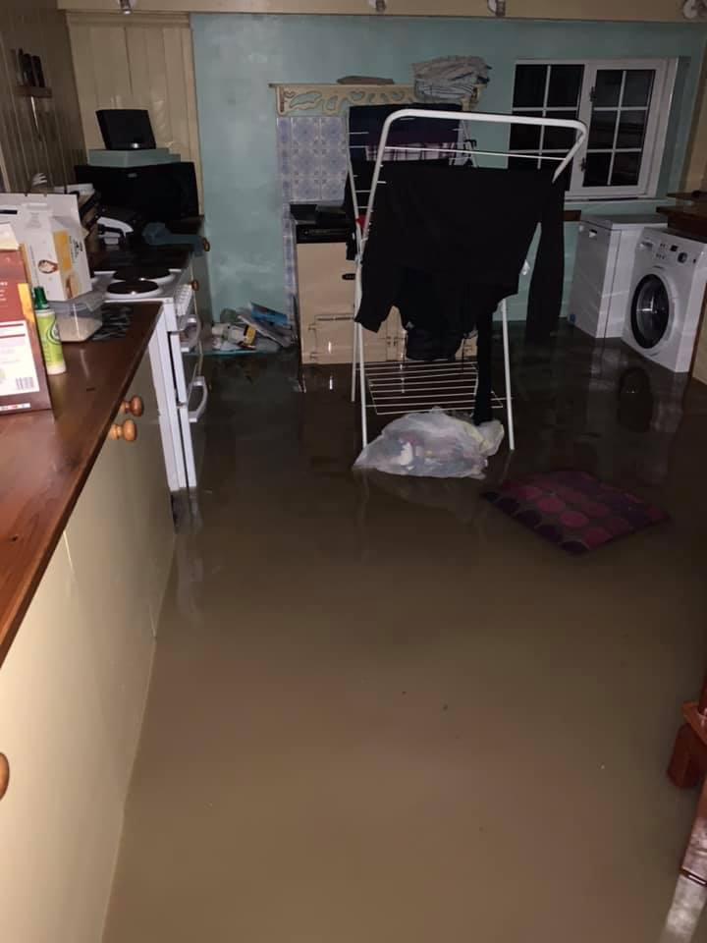
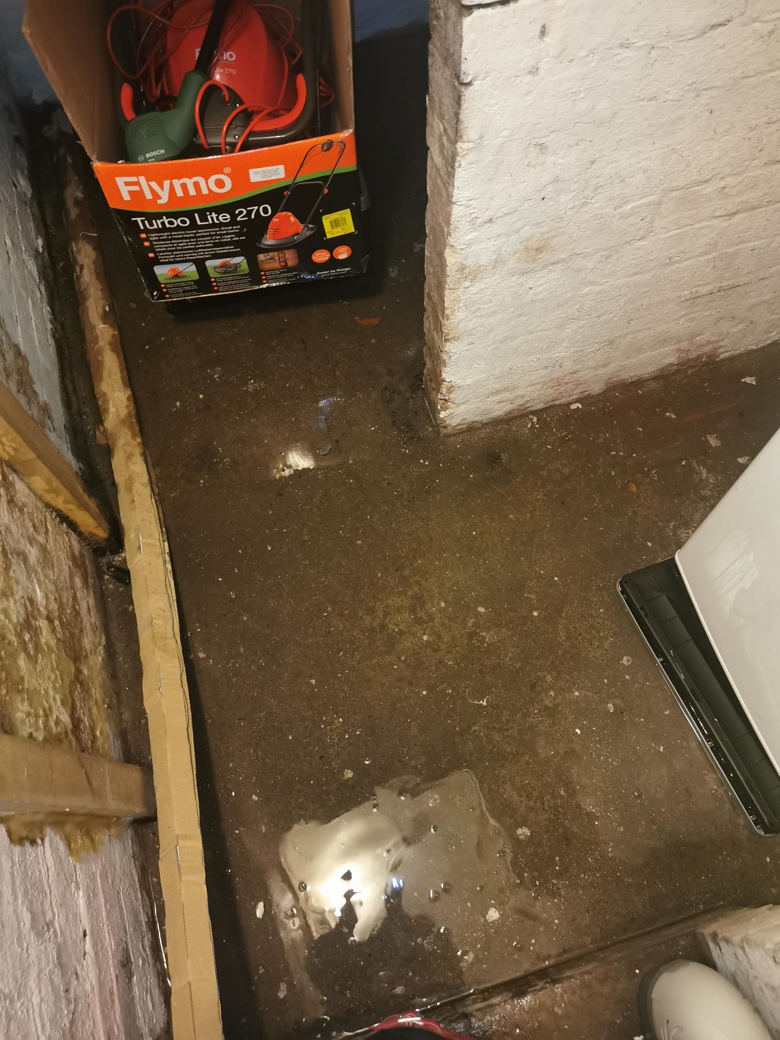
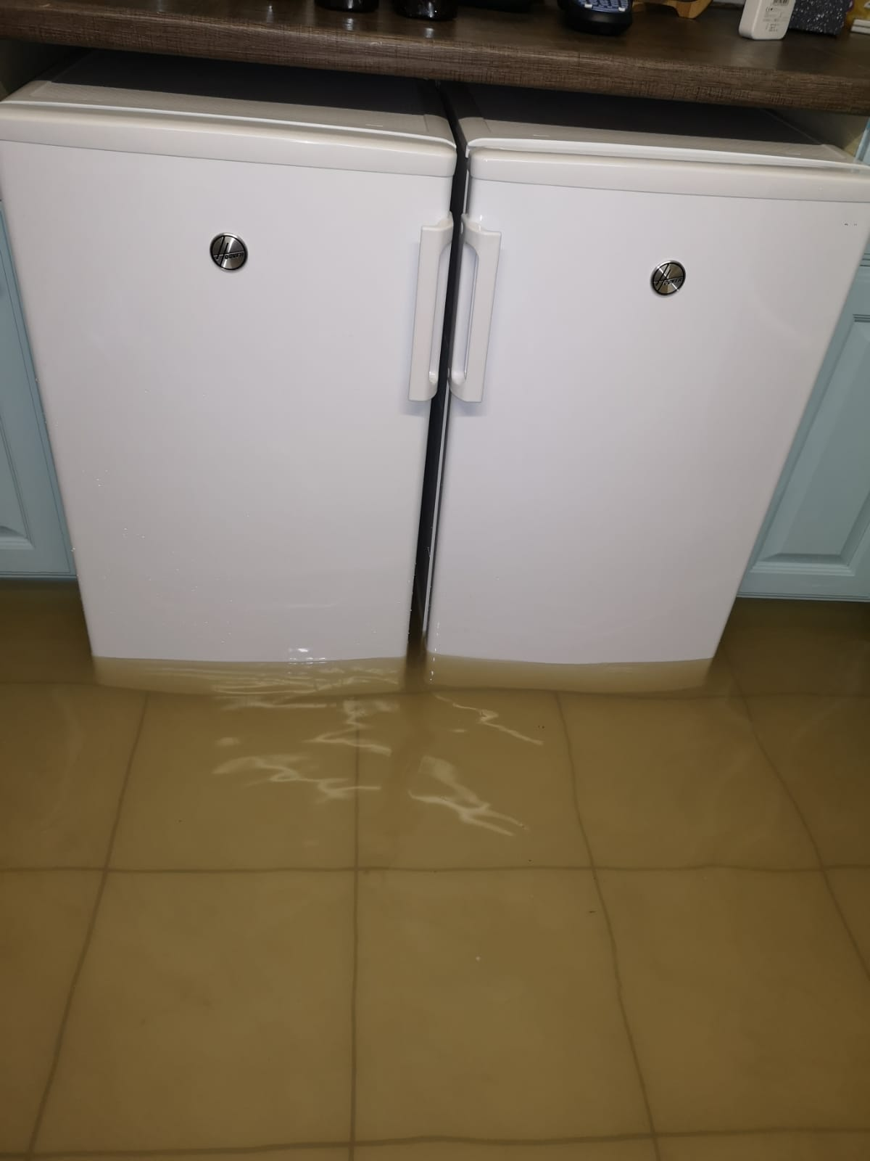
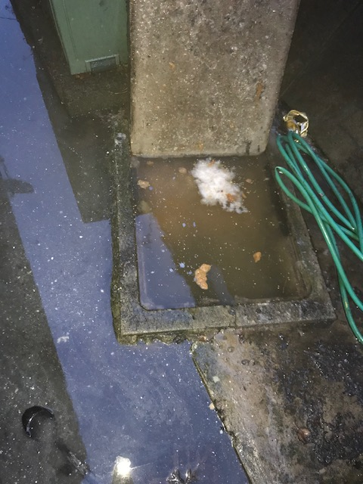
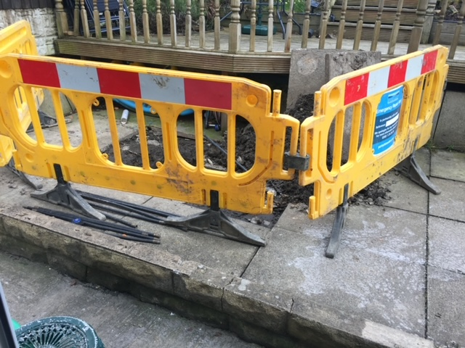
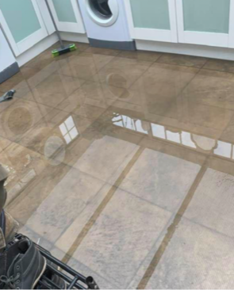
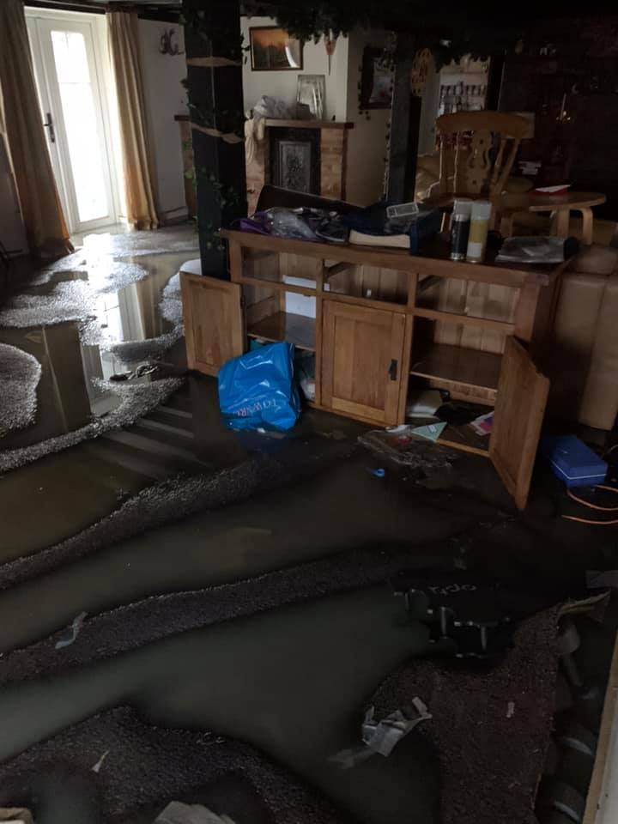
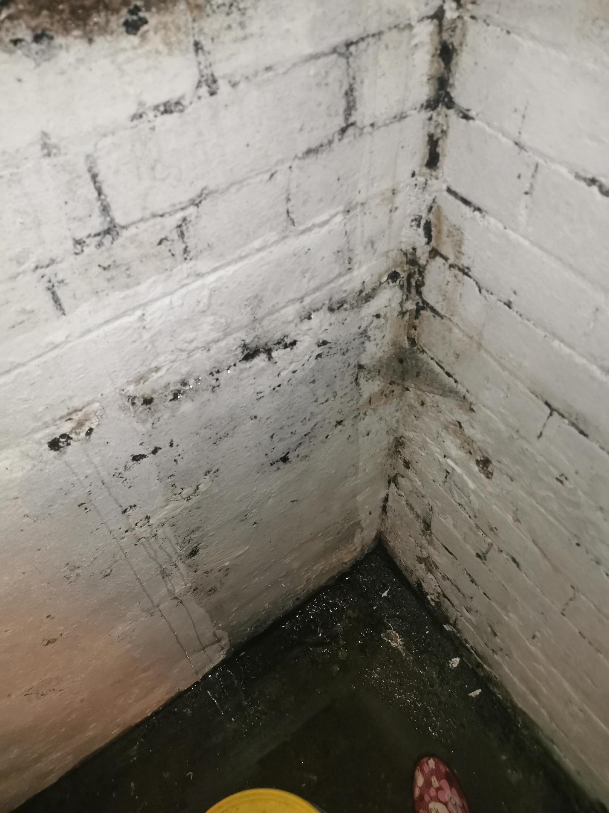
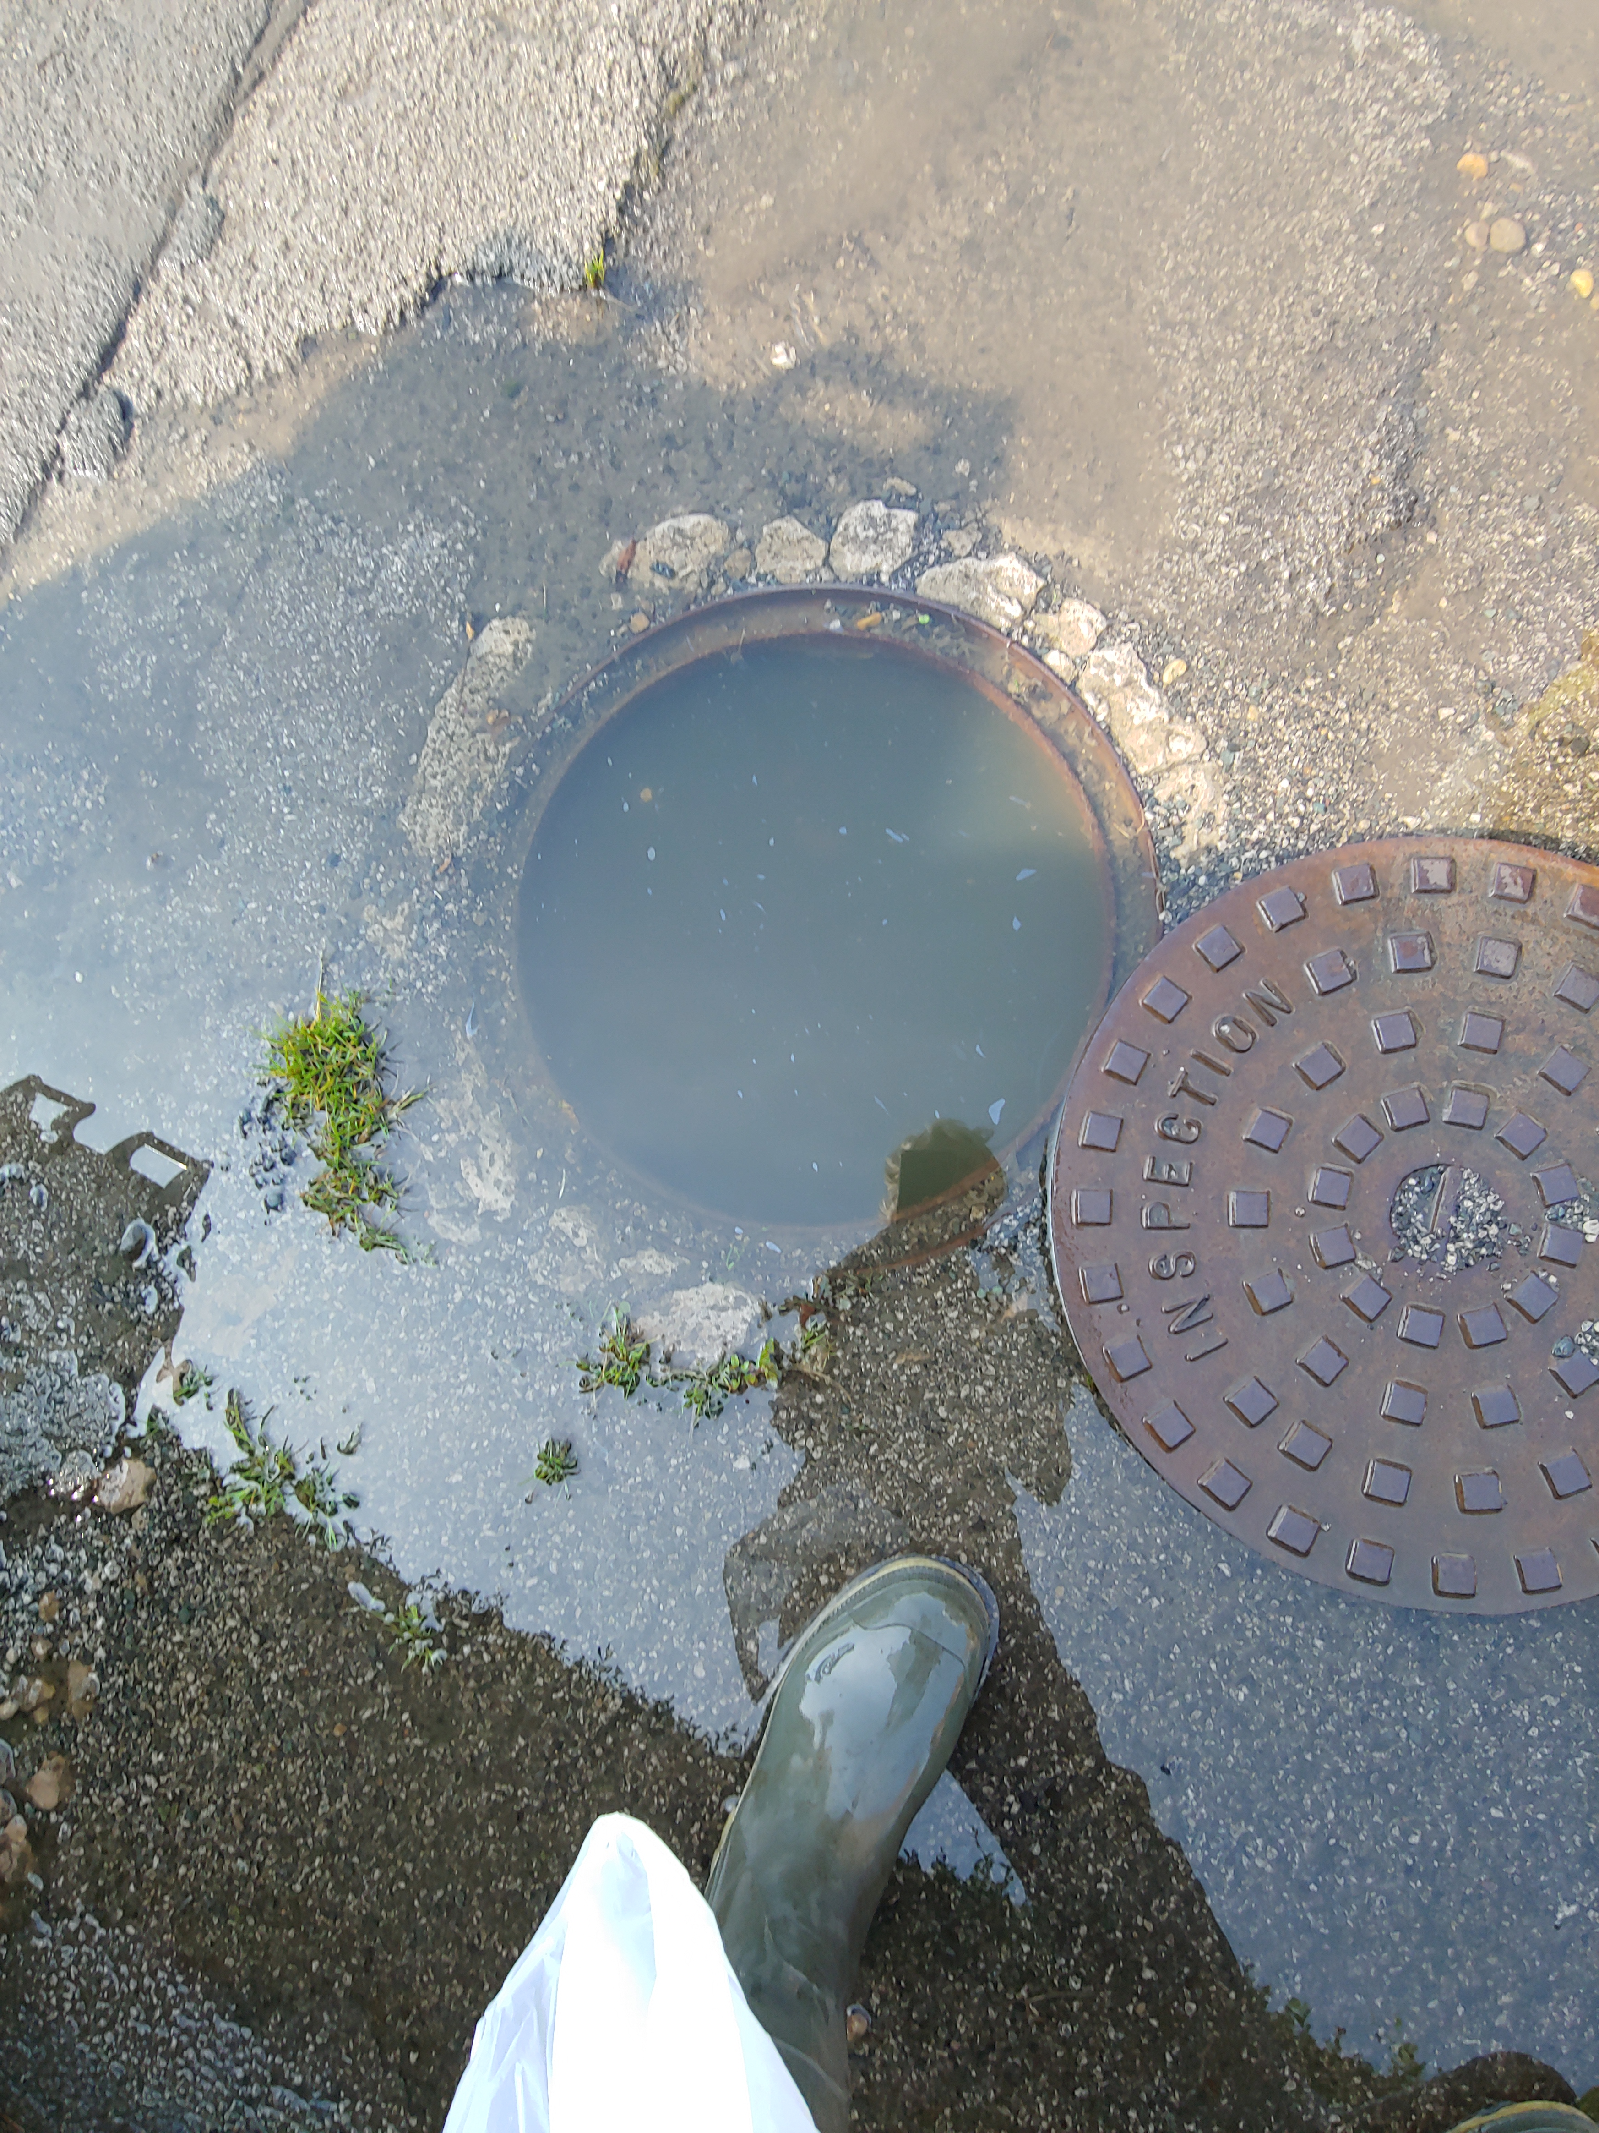
Overall, damage can be catastrophic
Participant photos

Slide 15



And the impact on customers far reaching and significant
“It meant I couldn’t use the bathroom if I had guests round, it’s pointless if you can’t use it. You can’t have a shower or use the toilet without it overflowing… My flat felt pretty gross, I don’t want to invite people over and them ask ‘why does your flat stink of eggs?’.”
Internal, single, low severity
”We’ve literally lost everything. When we got to the hotel, the clothes we were stood in had to be destroyed because they were contaminated.”
Internal/external, multiple, high severity
“You can’t really use the toilet or you’re going to make it worse. There’s smell, and dirt. It’s always a bit of a worry… ‘Oh, we’ve not had a blockage for 6 months – one’s due!’.”
External, multiple, high severity
“What it meant was that we weren’t able to use the ground floor. The damage was to all of the carpets, any furniture that was on the ground level had to be scrapped. We are only just getting back to normal”
Internal, single, high severity

Slide 16
Alongside practical and emotional damage, sewage flooding triggers deeper emotions of shame and embarrassment
“Initially it was fine, the smell was bearable, but it was quite disruptive. It was Eid, we couldn’t sit in our lounge of have guests coming here – it’s quite disgusting and disrespectful. We did Eid at my sister’s house instead.”
Internal, multiple, very high severity
Alongside the practical impact of the flooding event and damage caused, feelings of shame and embarrassment are also frequently cited, adding to the emotional impact. This is driven by:
The basic association of sewage flooding with “unclean” and “unsanitary”.
A sense of personal responsibility for the cause, regardless of what the actual cause was (this is often driven by water companies themselves).
“My initial thought was that I had done something wrong because that’s what they warn you about, so I was a bit embarrassed.”
Internal, single, low severity
Associated impacts of flooding such as a lingering bad smell or unsightly external damage.

Slide 17
Crucially however, experiences are also characterised by a sense of disempowerment or resignation
Across the wide spectrum of experiences relating to flooding events, customers surprisingly also frequently demonstrate a sense of disempowerment or resignation driven by:
A belief that ‘others have it worse’ either in terms of flooding events or more broadly in the world today, and therefore they shouldn’t complain.
A perception* that they have little power or control over the situation at hand, and therefore must simply ‘put up’ with it.
“I just felt like I guess I can put up with it – other people around the world have worse problems.”
Internal, single, low-medium severity
“What can we really do about it? We're sort of stuck with the water utilities we have; it's not like we can pick and choose.”
External, multiple, high severity
*For many, this perception is felt to be ‘proven’ by the perceived lack of adequate response from their wastewater company.

Slide 18




There is a strong need to recognise that all sewage flooding events can have a huge negative impact on customers, causing both practical and emotional damage in the immediate and longer-term.

Slide 19
Furthermore, the aftermath of the event can be as or more distressing than the trauma of the event itself
The event can be made worse in two key ways:
The process of resolution being drawn out, or a resolution not being reached, leaving customers to continually manage the administrative and logistical process of liaising with their wastewater company and for some, to experience repeat or regular sewage flooding.
Whilst the initial event is distressing for individuals, the events that follow can actually equal or even overshadow it.
A lack of empathy or compassion from wastewater company representatives, which can add further distress, trauma and embarrassment to the situation.

Slide 20
04
The customer journey and wastewater companies’ response

Slide 21
Ideally, there are four key stages to a customer journey for those that have experienced a sewage flood:
Contact
Conversation
Action
Resolution
The customer being clear about who to contact, and making first contact in regard to the sewage flooding
The conversation between customer and wastewater company to confirm details of incidence and response from wastewater company
Intervention from the wastewater company to investigate and potentially fix the problem
The problem is fully and permanently resolved to the satisfaction (both practical and emotional) of the customer
Customer mindset
Stress, anxiety, sense of urgency
Anxiety, anger, sense of urgency
Relief if fixed and cause identified
Want to confidently move on with life
Broad expectations
Quick and easy to contact
Empathetic and responsive, reassurance
Timely action, continued empathy, fix cause
Permanent fix and full communication

Slide 22

In reality, customers’ experience is messy, non-linear, requires considerable effort, and often lacks clear resolution
Customers often have to make contact several times, experiencing a lot of ‘back and forth’ between them and their wastewater company, before any action is taken
Contact
Conversation
Action
Resolution
Customers often have to contact multiple organisations (insurance, local plumbers and wastewater companies) to get clarity on who they should be speaking to
Customers often have to repeatedly go over the details of the event to multiple individuals at the same company
Water companies often take some action (e.g., clean ups or temporary unblocking) but do not permanently fix the issue
Many customers do not get a clear resolution from their wastewater company – they are either left chasing one, or have to ‘give in’ to what they are offered despite it not being satisfactory

Slide 23
Most customers contact their wastewater company first, yet responsibility for sewage flooding is not common knowledge
Most customers contact their wastewater company first, especially those who have experience of repeat sewage floods, and situations where the flood is unmistakably a ‘leak’ or drainage problem.
Customers usually reach out to their wastewater company by phone or, if available, instant messenger due to the urgency of the situation. A few use online forms if they think it is not an ‘emergency’.
“At first I called a plumber but they said it was a shared drain and I could get the water company to do it, so I did that.”
External, single, high severity
Contact
When customers contact other organisations, it is often due to inexperience, confusion around responsibility, or multiple causes for the flood (e.g., heavy rainfall and river flooding as well as sewage).
In these situations customers use Google to find local plumbers and drain companies (e.g., Dyno-Rod). Insurance companies are also often contacted first following severe flooding, due to customers being aware they need to do this promptly in order to make a claim. The local authority might also be contacted.
“I called the council, because they’re the people who collect the bins, and bring sandbags now and then when the river may flood… I got nowhere until someone told me to contact [my wastewater company].”
External, single, low severity

Slide 24
Lack of clarity about who to contact, as well as anxiety about liability/costs, can exacerbate the stress of the situation
There is mixed knowledge about whose responsibility a sewage flooding is, which is felt to be exacerbated by communication from wastewater companies which often highlights the role of the customer i.e., most blockages are caused by customers flushing incorrect items. This message is often reiterated by customer service agents who are often felt to start with the assumption that customers are at fault, even if the issue is found to be the company’s responsibility.
As a result, customers often explore other options first due to fear of being charged for the call-outs and damage if they are wrong about who is responsible.
In situations where individual flooding events have multiple causes (e.g. if surface flooding happens at the same time), customers can feel that responsibility for different types of flooding lies in different hands. They describe organisations pushing blame between one another, leaving the customer anxiously caught in the middle without a clear path to assistance.
“Someone came round and banged on my window when it first happened – I didn’t know what to do, did I need to deal with it myself?”
External, multiple, high severity
“I called Dyno-Rod – or someone like that – because I thought my builders had caused it, but I called the water company when it started happening again.”
External, multiple, low severity

Slide 25
Being “questioned” about flooding events, having to repeat details and provide evidence can further distress customers
Customers who reach out to their wastewater companies often describe being asked a series of questions about the sewage flood they are experiencing. This includes what exactly is happening, where on their property, the extent of the flooding, and details such as if anyone living at their property is vulnerable.
Some customers report being asked to provide evidence of the issue, which in some instances is not feasible given they have done their own quick clean-up.
“They seem knowledgeable, understand what I’m explaining to them. I never feel I’m being brushed off in anyway… Most of the times I’m on my own and not trying to make myself a priority”
External, multiple, high severity
Conversation
After providing this information, most are given a time frame in which someone will visit (although a few report being told ‘as soon as possible’ rather than a specific window). Some are told if this will be an engineer to investigate and determine next steps, or a clean-up crew.
“When I did contact my water company, it’s a big company, I didn’t expect the promptness of someone being there the next day.”
Internal, single, high severity

Slide 26
Experience of action to provide an immediate “fix” the problem is variable
For customers who contacted their wastewater company first, they generally allocate a time slot for an initial call out, which happens anywhere between a few hours and a few days. Engineers sent out will conduct investigations to identify what the problem is, ‘fix’ it themselves if possible (i.e., stop the flooding, either temporarily or permanently) and if not, recommend next steps to fix the issue. Where required, customers have a clean-up crew sent after this, with some needing two visits, one to remove remaining sewage and another to disinfect the area. Some customers fully or partially clean up themselves rather than wait.
Where the problem is not easily resolvable, the stages of action can be extended or repeated for customers. For example, they may have repeat visits from engineers to further investigate or provide a temporary fix.
“Within a couple of days I had an initial visit, they were pouring dye down sinks, plug holes and keeping an eye on the flooding water. They took a sample of the water that day as well. I didn’t understand the practice, but it all seemed a reasonable course of action.”
Internal, multiple, high severity
Action
“The very first thing I did the next day was contact my insurance company, to get that moving. They gave me references, people to speak to… I feel like I was in contact with them almost constantly after that.”
Internal, single, high severity
When private plumbers and drain companies were contacted first, those who visited customers’ properties often recommend getting in touch with their wastewater companies at this stage, identifying it wasn’t a fault in the customer’s drains and being familiar with wastewater company responsibilities.
Insurance companies were often contacted first in the case of severe flooding. Because of this, the initial response often involved collecting evidence (including what customers can provide and the insurance company sending representative to inspect the damage) followed by the company themselves taking some action (e.g., sending dehumidifiers) or instructing customers to contact their wastewater company for a resolution.

Slide 27
Because of the emotional impact of sewage flooding, full resolution only occurs when customers feel (and know) the cause is dealt with
Customers face issues not only in getting the ‘symptoms’ of the sewage flood fixed, but also to have the cause addressed so they can feel assured it won’t happen again. For some, the cause of the flood is a ‘quick fix’ (such as cleaning a one-off blockage) while for others the causes are longer-term (like a damaged pipe needing repairs, or having faults that cause repeat blockages).
In the case of ‘quick fix’ sewage floods, customers can feel the problem is resolved by their wastewater company or private plumber / drain company, as cause and symptoms are usually addressed in one go. However, this is less likely to be the case with longer-term problems. Customers are less likely to report fixes of these issues, and instead have the symptoms addressed each time a flood happens.
Some customers who contact their insurer note that to feel the issue has been fully resolved they have to go further and pay out of their own pocket for their own flood defences.
“By the look of it, the pumping station is inadequate to cope, with climate change making things worse. Two years on, we’ve had no real feedback on what’s going on. Are they looking into it?”
Internal, single, very high severity
Resolution
“We’re trying to make our home have that feeling of security again, but it’s going to be a long time if ever. And the amount of money we’ve had to pay out for the defences, it’s still affecting us. We had to get a mortgage payment holiday to pay for the work.”
Internal, single, high severity
Customers who do not feel they have been given a resolution will sometimes raise a complaint with their wastewater company, get in touch with their local council, or get in touch with Ofwat and/or CCW (although many had never heard of Ofwat or CCW prior to the research). This is often to try to exert pressure on their wastewater company to take longer-term preventative action (which is not often initiated proactively).

Slide 28
Individual interactions with wastewater companies are often positive in the early stages, however this is not universal
First contact
Generally, contact details are easy to find online, and customers report quick response times on the phone. Some also note positive experiences in alternative contact methods e.g., online forms or WhatsApp...
… However, some report a lack of clarity on who to contact, difficulties in finding contact details or frustrating automated systems that leave them on hold.
Customer service
Customer service agents are frequently described as demonstrating empathy and compassion in their tone, as well as calmness and professionalism…
…However, a handful of customers describe a lack of sincerity or even insensitivity. A larger number note eagerness from their wastewater company to emphasise the customers responsibility only.
Unique interactions – may occur more than once in the case of multiple flooding events
Initial action
Most customers describe being provided with straightforward ‘next steps’ by call agents, and a call out from an engineer within a few days, with the timeframe being in line with the severity of the issue…
…However, some customers note a lack of clarity on next steps or unsatisfactory timeframes, which is felt to indicate a lack of urgency, and can create planning issues for the customer.
Visit
First call outs are normally positive. Engineers are frequently described positively both in terms of their customer service and the actions they initially take…
….However, some customers note frustrations with engineers not showing up for appointments or being unprepared or unable to resolve the issue initially, meaning a follow-up appointment has to be scheduled.

Slide 29
These one-off positive interactions, however, are matched by a clear and steep drop off in the quality of service over time
Many customers praise the behaviour and tone of call agents and call-out crews they have direct contact with. However, these are seen as unique interactions, the value of which diminishes as customers continue to face ongoing challenges reaching a point of resolution after their sewage flood. Service overall is therefore seen to deteriorate over time, including:
A lack of proactive updates, with many customers noting they had to constantly chase for information.
Interactions not being linked up, including the wastewater company not keeping notes or a log of ongoing issues, meaning that customers need to start from scratch with each new interaction or event.
Poorly arranged visits, including delays, no shows or conversely engineers arriving unannounced.
A lack of action or resolution, including a lack of thorough investigation of the problem or lack of updates with findings from an investigation that has reportedly taken place.
The extent and emotional impact of these problems are felt to worsen over time

Slide 30




Overall, customers report predominately negative experiences with water companies, with positive experiences being in the minority

Slide 31





Case study: High severity, internal, single event + negative customer service experience
Stephanie* lives with her autistic nephew in a 3-bedroom, semi-detached home that she rents from a housing association. She experienced a one off – but highly distressing – event.
SEVERITY SCORE: 10/10 The specific event as well as the follow up action caused significant distress for Stephanie.
Covered in sewage, she ran outside to where the wastewater company were doing works. The workmen laughed at her and ‘didn’t care’.
The wastewater company called her stupid and she felt they withheld information thinking she wouldn’t understand. She also felt they did not understand the impact that this could have had on people with special needs (i.e. if it had been her nephew instead of her).
Time
Stephanie was sitting on her toilet when sewage started jetting out of it.
She was offered a ‘standard level of compensation’, which she felt was insufficient for her experience; she eventually managed to negotiate a payment of £350.
Stephanie cleaned up her bathrooms and herself, before calling her wastewater company. They did not believe her because she had not taken any photos of the incident before cleaning it up.
“The workmen didn't care. I was soaking wet, and they laughed at me. It was just ‘oh well, never mind’, there was just nothing to it.”
“Nobody seemed shocked, nobody said 'oh that's awful, we're really sorry’. No acceptance… It was just very blasé about it as if this was just a normal thing that happened, and that kind of attitude of ‘oh well, never mind’ was just not very helpful given what happened. It wasn't just that my bathroom flooded, it was that I was on the toilet at the time.”
“I said ‘I've literally had water squirted up my backside, I'm not sure your ordinary compensation cuts it’.”
*Names have been changed. Severity scores based on customer's perception of impact

Slide 32


Case study: High severity, external, multiple events + negative customer service experience
Ellie* moved into her dream home 5 years ago, with her husband and two teenage children. Her experiences with sewage flooding began in 2019, and now take place regularly when it rains.
SEVERITY SCORE: 9/10 The significant impact of the flood has been exacerbated by the response from her wastewater company.
Ellie finds that her wastewater company has an incomplete log of events at her property. She also has difficulty asking for a clean up crew to be sent out immediately following flooding events rather than waiting for engineers to come first (as she knows they will just recommend a clean up).
She has struggled to receive compensation or complain to Ofwat/CCW because her case has not been closed by her wastewater company.
Time
Every few months since 2019, the drains in Ellie’s garden overflow during heavy rain, flooding the area directly outside her house.
Ellie has a long-term
complaint with her wastewater company. She is often swapped between different agents and thinks this is so they can give the same excuses for not taking action.
“I’ve been on hold for over an hour… They’re nice enough, they just don’t know. ‘Aw, that sounds terrible’, all the usual. I tell them ‘you don’t need to send an engineer, we just need a clean up crew. I feel I shouldn’t have to keep repeating myself, I need a panic button!”
“I’m normally quite a laid-back person, but this has reached the point that I get quite cross with it now… when we had the flood at Christmas, I was in tears, and the guy was really rude. He’s the only one I’ve ever shouted at.”
“I spoke to them before about GSS payments and they brush it off… Because it doesn’t affect half of my property, ‘it doesn’t matter’ – but it affects the bit I live in! I have to move my car when it’s really bad. I have a little moat around the house.”
*Names have been changed. Severity scores based on customer's perception of impact

Slide 33
In fact, responses can significantly alter the initial impact of the event itself
Low level of customer service*
Low impact, low service: Response negatively overshadows the event itself.
High impact, low service: Response significantly heightens the initial emotional impact.
A worsening of customer experiences
Low impact*
High impact*
Low impact, high service: Response exceeds customer expectations and further dilutes impact of event.
High impact, high service: Response has potential to take away some of the initial distress caused.
An improvement of customer experiences
*As defined by participants
High level of customer service*

Slide 34
If flooding happens across neighbourhoods, this can mitigate negative experiences but also create further frustrations
Some customers, particularly those affected by repeat flooding, describe supportive community networks emerging as a result of these events.
However, for other customers, being one of many affected in the same event can actually worsen the experience.
These networks are firstly used for ongoing communication on the situation or to act as evidence of problems e.g. WhatsApp or email to update others on heavy rainfall potentially causing a sewage flood.
However, they are also used as a form of ‘strength in numbers’, to pressure wastewater companies to investigate and address the root cause or escalate the issue to their local MP.
Whilst only a minority experience, one customer reported being unable to access documents for their insurance claim because their wastewater company had tied the entire event to the first person to get through on their call lines.
Another customer noted frustration that despite being flooded by the same incident as her neighbours, she could not get through on the phone to report it, and so she was not able to get assistance from staff already on their street.

Slide 35
05
Communication change

Slide 36



To address poor service experiences, water companies should start by examining their approaches to communication, as this is felt to be the key driver of a positive or negative experience

Slide 37
Customers want wastewater companies to deliver against four key communication principles throughout flooding events
Customers felt that communication from wastewater companies was not currently delivering on these aspects:
Be accessible
Customers want quick and straightforward ways to report the issue to their wastewater company.
Demonstrate empathy
Customers expect those working for wastewater companies to demonstrate compassion for their situation.
Be proactive
Customers want their wastewater company to lead communication with them and follow through to give updates on the situation without being prompted.
Maintain transparency
Customers want to see their wastewater company be open about the cause of the problem, the work they are doing and the challenges they may be facing.

Slide 38


Be accessible
Customers want quick and straightforward ways to report the issue to their wastewater company..
Current issues faced by customers: Difficulty figuring out who to contact, especially when experiencing flooding for the first time. Having to navigate automated phone systems and potentially sit on hold for a long time, even when they have an open case or have experienced multiple flooding events. Customers having to spend huge amounts of time and energy to follow up and attempt to resolve their issue.
Customers want their wastewater company to have dedicated modes of contact in the event of a flooding event which includes:
  24/7 phone availability (the preferred mode for most), including the option to go straight through to a person rather than an automated system when they have an open case or have experienced multiple events.
  Alternative forms of contact such as online forms or WhatsApp for less urgent situations.
Customers also suggest wastewater companies take steps to publicise accessible points of contact before customers experience sewage flooding. Customers note that information on customer’s responsibility for their own drains is well publicised, but there is little on the wastewater company’s role.
“I never received letters, leaflets or notifications – they need to be more proactive, telling people what to do in areas where flooding is common.”
Internal, multiple, low severity
Ideal response
“There has to be some mechanism where you can get through to customer services, and they understand or have a list of highly vulnerable areas that they respond to in a timely manner and consistently.”
Internal, multiple, high severity
Accessible contact gives customers reassurance about the situation and confidence in their wastewater company.
Customers also note practical benefits, as faster response times can help contain damage.
Impact of response

Slide 39
Demonstrate empathy
Customers expect those working for wastewater companies to demonstrate compassion for their situation.
Current issues faced by customers: Some customers have felt dismissed, or that wastewater companies are not fully engaging with their issue. They believe that wastewater companies make limited effort to understand the physical and emotional impact of the sewage flooding on them, including understanding their personal circumstances. Customers have to re-explain their experience each time they get in contact because they speak to someone different each time, meaning they have to relive the emotional turmoil of their event(s) over and over.
Customers want their wastewater company to show that they recognise how stressful experiencing sewage flooding is, and for customer service agents and other staff to demonstrate empathy, compassion and understanding in their tone and manner.
Keeping a record or log of interactions with customers and using this effectively to make interactions less emotionally draining (e.g., removing the need for customers to repeat their circumstances). This would demonstrate that the wastewater company cares and is listening to the customer, and is taking their case forward.
Included within this, is a desire to see wastewater companies also take steps to understand the customer’s personal situation and if there are any factors (beyond being on the priority register) which may make the situation particularly stressful for them.
“They should change their attitude, to make sure their customer service is good and really try to understand their mistakes in that and learn from them.”
External, multiple, high severity
Ideal response
“It’s all about reassurance, being there, communicating with the person affected, that’s taking control of what is happening.”
Internal, single, high severity
“Coming out four days after the event doesn’t show any empathy!”
Internal, single, very high severity
An empathetic tone can help comfort customers in their time of need, thereby helping to reduce the negative impact of the event. It can also build trust in the wastewater company and provide reassurance that the problem is being taken seriously and so will be addressed.
Impact of response

Slide 40
Be proactive
Customers want their wastewater company to lead communication with them and follow through to give
updates on the situation without being prompted.
Current issues faced by customers : Lack of proactive updates on action being taken to address or resolve an issue, with customers reporting having to constantly chase for information. Customers report having to spend a lot of time and energy chasing wastewater companies. Even when customers do receive updates from their wastewater company, there is often no follow through with updates or, ultimately, delivery.
After they have reported the issue to the wastewater company, customers then want to hand over responsibility, and see them ‘take control’ of the situation.
They want to see wastewater companies proactively outlining the actions that will be taken and, importantly, following through on those actions without further chasing from the customer. This is also key if there is a need for them to collaborate with others e.g., insurance companies – customers want to avoid being the middle man and instead see collaboration between stakeholders.
They also want to see wastewater companies proactively finding out the customers’ needs in relation to how the flooding and response impacts them, rather than the customer having to know to offer this information themselves or ask for additional support.
The most crucial part of this is a desire for the wastewater company to give proactive updates on the situation, including updating them even when little or no progress has been made and giving clear timeframes for next steps.
“It would it be helpful for the water companies to have an obligation to prepare a mitigation plan, in order to reduce the risk of it happening again, so that there's accountability to individuals and community.”
Internal, single, high severity
Ideal response
“If there has been a risk assessment in regards to sewage flooding, they could have invested in the work they did before anything happened, rather than after.”
Internal, single, high severity
Proactivity from wastewater companies reduces the time and energy required by customers to contact them or chase for answers.
Whilst this has practical benefits, it also serves to give customers peace of mind knowing that the situation is being managed without their input.
Impact of response

Slide 41
Maintain transparency
Customers want to see their wastewater company be open about the cause of the problem, the work they are doing and the challenges they may be facing.
Current issues faced by customers: Customers often report a lack of thorough investigation of their problem from wastewater companies, including the absence of a plan of action/timeframes for achieving a resolution. Alternatively, some are aware of investigations having taken place but have never been told the results. On a day-to-day level, many also report poor communication regarding arranged visits from wastewater company representatives (e.g. engineers) including delays, no shows, or arriving unannounced, making it difficult for the customer to follow any progress being made and leaving them feeling unsure of next steps.
Customers want to see wastewater companies be open and transparent about the situation, including issues that are being faced, outcomes from investigations, and reasons for delays.
In most instances customers are aware and understanding that wastewater company money is finite and that some degree of prioritisation is needed when assessing different customers and events. However, customers would like wastewater companies to be honest about such issues, both to manage their expectations and minimise frustrating back-and-forth communications.
“I’d like a written report about the situation with reassurance – as this is happening too often! That ‘this is what we’re going to do’.”
External, multiple, high severity
Ideal response
“Address the issue, rather than putting a plaster on it. And they should also communicate to the affected people that they’re doing something about it.”
Internal, multiple, low severity
A transparent approach helps to build customer trust in their wastewater company more broadly, which then translates to reassurance that they are taking responsibility for issues and addressing them accordingly.
Impact of response

Slide 42
Although some prioritisation by customer type is expected, this should not negate minimum standards of service for all
Customers agree that wastewater companies should implement some degree of customer prioritisation:
However, they also reference other circumstances that should be considered:
Customers agree that those on priority registers should receive prioritised service, feeling that being elderly, having a disability or having young children is likely to make flooding impact more severe. Customers also generally see internal events as having the greatest potential to be damaging vs external events and expect some degree of prioritisation here as well.
Customers are keen to highlight additional circumstances that could also impact the level of impact of flooding, but may get missed in basic assessments done by wastewater companies including poor mental health, working situation (e.g. a zero hours contract which makes taking time off more challenging) or lack of access to alternative accommodation.
It is therefore seen as critical for wastewater companies to deliver strong and consistent customer service to all groups, and to take steps to understand specific personal circumstances that may influence the impact of the event on individuals beyond being on the priority register.

Slide 43
06
Resolution and compensation

Slide 44



As well as needing to improve communication, there is a need for water companies to look into their resolution processes

Slide 45
Currently, too few customers are experiencing satisfactory resolution of their sewage flooding problem
Across this research, fewer than a quarter of customers who took part felt that their wastewater company had given them a resolution that they were satisfied with.
However, not only are a significant number of customers still waiting for a resolution, but there are also reports of wastewater companies using avoidance and “pressure” tactics (e.g., giving customers no other options) in relation to resolutions.
“The new resolution would be a new pipe… I’ve been told it’s on a list of problems they review every five years. They have said it’d be £140,000 to fix It, and I think they don’t want to pay.”
Internal, multiple, high severity
“It’s a level pipe [so sewage won’t drain away] They know the problem, and they won’t sort it out.”
External, multiple, low severity

Slide 46




Case study: Low severity, internal, multiple events + negative customer service experience
Nathanial* lives with his wife and young son, having moved into his current property in 2013. His problems have been ongoing for the past nine years and he feels let down by his wastewater company.
SEVERITY SCORE: 10/10 Whilst individual events are low impact, the ongoing nature of the issue has caused extreme stress and frustration.
Time
Nathanial has being fighting his wastewater company on this issue for over 8 years, with multiple forms of contact, even escalating to a lawyer, his local MP and Ofwat.
Upon contacting his wastewater company, they quickly came to ‘flush’ the drain, however the problem soon re-emerged.
In 2013, Nathanial started to experience problems with drainage, smells and sewage coming up the toilet, bath and sink.
Upon further investigation Nathanial’s wastewater company found the real problem to be a broken pipe but refused to fix it due to expense.
Nathanial has been told he is on a wait list to get his pipe fixed, although no timeframe for resolution has been given.
“If it happened just the once you could deal with it, but its constant. You worry about the harm you could be doing to your child - is he going to get a long-term health issue because he's bathing in potentially unclean water? Is the air clean?”
“It’s taking a massive amount of time and energy. I feel like a dog with a bone, I don't want to let go. They shouldn't get away with it. Even if we moved, I would feel bad on the next people. I can't forget about it because it keeps happening.”
“At first, I thought the flushing was sufficient, but slowly over time you realise its not okay. And then you realise it’s a long-term problem that is being ignored.”
*Names have been changed. Severity scores based on customer's perception of impact

Slide 47

Case study: Low severity, internal, multiple events + positive customer service experience
Dean* lives alone in a small village with his two dogs. Whilst he has experienced multiple events, strong customer service has minimised the impact.
SEVERITY SCORE: 6/10 Whilst the event itself was felt to be a major inconvenience, the wastewater company response has reduced impact.
Time
Dean experienced further flooding issues, however his wastewater company again were quick and efficient in unblocking the pipe.
Last year Dean started to experience drainage issues in both his shower and his toilet.
Dean’s wastewater company has proactively called him to check on the issue. Although it has not been resolved completely, Dean is happy with his current situation and feels confident should issues arise again, they will be resolved quickly.
The wastewater company were able to easily unblock a blockage in his waste pipe and delivered great customer service in doing so. However they warned the issue may occur again.
“The man that came out was such a lovely bloke - unbelievably friendly. He cared. He had all the time in the world for you. I’d trust him with my elderly parents, that’s the biggest compliment I can give.”
“What they have done right now is a temporary fix. They decided they would take a 'watching brief' on it so nothing more is being done for now. But that’s fine. I've got their number and know they will fix it quickly and easily if there is another problem. I am happy with how they’ve responded so far.”
“They understood the problem, they understood I have a life and I'm flexible. I had faith that if I couldn't have made that date they would have rearranged. it was very un-stressful. They did their job well.”
*Names have been changed. Severity scores based on customer's perception of impact

Slide 48
Furthermore, resolutions are felt to be linked to customers’ own efforts/resilience rather than wastewater company actions
Customers who were most ‘annoying’ or who ‘complained the loudest’ are seen to be best placed to make progress with their wastewater company.
The ability to act this way is normally tied directly to customer knowledge (e.g. an engineering background or experience working in local councils), as well as their level of determination and confidence. These individuals take actions such as persistent phone calls and/or requesting certain plans or documents to further their knowledge.
“Often there are inconsistencies in their measures; if you scream and shout your response can look different to someone who doesn't. I tend to kick up the greatest fuss and be the loudest in the area.”
Internal, multiple, high severity
However, not all customers have the same time, determination and/or ability to follow up with their wastewater company following a flooding event.
There is particular concern about vulnerable customers who are older, do not speak English well, who have mental health or cognitive conditions, or have less knowledge of their rights as a consumer.
“I’m expecting it to block every 9 months or so. I would hope I’d retire in this house – but when I’m really old, I won’t be able to do it anymore! It’s the only reason I’d move.”
Internal, multiple, high severity

Slide 49
Worryingly, this is felt by some customers to be driven by wastewater companies refusing to fully accept responsibility
Customers reported their wastewater companies outright refusing to accept responsibility for flooding events or, in some instances, indicating that they were responsible verbally but then not acknowledging this responsibility in writing.
When dealing with the aftermath of a flooding event, this refusal of wastewater companies to accept responsibility had a significant emotional impact on customers. Customers felt frustrated and unsure of who to turn to for a resolution.
This is particularly significant because customers cannot choose to switch to a different wastewater company if they are unhappy with the response. The lack of choice renders customers heavily dependent on their wastewater company to take responsibility to fix their issue.
A minority reported tensions across the same water company (waste vs clean) in accepting responsibility and working together.
“They were unconcerned. They were more bothered about not accepting liability, that is why they wouldn't provide compensation.”
Internal, multiple, high severity
“They’ve got a responsibility, they’re taking your money and charging for a service. So, they need to repair it when it goes wrong.”
External, single, low severity

Slide 50
Only a minority had escalated issues to Ofwat and CCW, however responses to this action were felt to be mixed
Most customers do not, or have not yet, escalated their case to Ofwat and/or CCW.
This is due to a mix or reasons; some are not aware/knowledgeable of Ofwat and CCW’s specific roles and responsibilities, some do not feel that their personal case warrants an escalation, and some simply feel dubious that contact (and the effort they associate with this, based on experiences with their wastewater company) would change their outcome.
Only a minority had escalated their issue to Ofwat and/or CCW, normally in relation to ongoing events that had not been resolved by their wastewater company.
For some, this did lead to action being taken by the wastewater company.
However, in another case the customer was told that Ofwat/CCW were not able to override what had previously been advised or communicated by the wastewater company.
“Proper prevention only happened once I contacted Ofwat and CCW, but even then, it was very reluctant.”
Internal, multiple, low severity
“I was in touch with Ofwat and CCW pre Covid-19 but gave up. I was told the cost is too high so they can't force anything.”
Internal, multiple, low severity

Slide 51
Water companies should reassure customers that they are working towards the ultimate resolution: ‘fixing the problem’
Actions customers want wastewater companies to take to achieve a resolution:
Immediate/short term Longer term
Accept responsibility
While this is not a standalone resolution, it is seen as a first step towards the wastewater company taking the necessary longer term action to resolve the problem, in turn providing reassurance to the customer.
Initial fix and mitigation
Customers want wastewater companies to work proactively between events to prevent or minimise the impact of flooding, and/or provide advance warning, sandbags, etc. when they know a flooding event is likely.
Long-term / permanent fix to the problem and preventative action
This is ultimately what customers want. They are understanding that this cannot necessarily happen immediately due to budgets and other planned work already being in the pipeline, but at minimum they would like to be communicated a plan so they can set their own expectations and feel reassured that action is being taken.
“If they had apologized and said ‘it was a failure of our system’, that would’ve been good.”
Internal, multiple, high severity
“As a minimum standard, they should not be letting sewage come out their drains.”
External, single, low severity
“They need to be penalised for not fixing things. If damage is caused, fix it!”
External, single, low severity

Slide 52
Resolution is the main goal for customers. Compensation is secondary, and is also rarely being offered
Reports of compensation being offered are minimal across the customer sample.
For some who had received it, there is a perception that it was insincere or used as a means to “fob off” the concerns rather than dealing with the issue itself.
Others report a need to argue with the wastewater company about the compensation value and even then, note what they were offered was insufficient to cover the physical and/or emotional impact of the event.
“It’s a cheap fix, a few hundred quid for something that will take the value of your property down by thousands and thousands, plus your insurance premium over the years will be far more than they will ever compensate you and what they’ve saved is tens of millions in what they need to do, so it’s a cheap, cheap way of dealing with it.”
Internal, multiple, high severity
“The final offer of compensation was a joke. But my husband is fed up of arguing with them, fed up of me being upset about it. So, we settled under duress.”
Internal/external, multiple, high severity

Slide 53
Although not a substitute for fixing the problem, customers do see an important role for compensation
Customers feel it is important that any compensation offered is not prioritised over, or used as a substitute for, making the broader infrastructure improvements that would fix or prevent the problem they had experienced or were continuing to experience. However it should “properly” compensate, e.g. in the following instances:
“What I’d rather is that they offset the cost of losing all my stuff.”
Internal, multiple, very high severity
To reimburse costs spent in managing the issue e.g. buying sandbags and barriers (although the preference would be for wastewater companies to provide these) and/or to reimburse physical damage to property and possessions
To cover the cost of insurance excesses when the flood is proven to not be their fault, and/or the cost of higher insurance premiums following the event
“Most people won’t expect compensation. Personally I think more about, like for like costs and cleaning up the mess afterwards.”
External, single, low severity
To address emotional damage and the extent to which experiences of flooding can impact lives
“Compensation should be made based on the size of the flood, and the stress, inconvenience and trauma it’s caused.”
Internal, single, low severity
As a form of fine/deterrent for wastewater companies to avoid flooding events from occurring; in which case the compensation paid would be a large sum and/or increasing with repeat events

Slide 54
Spontaneous awareness of the GSS guidelines was low, and upon review, they are found to be significantly lacking
There were few instances of automatic payments being offered to customers, usually in cases of repeat events or particularly severe single events. Difficulties challenging wastewater companies to pay were more common, and actually receiving compensation unlikely.
Furthermore, customers felt they could be improved, with key issues cited as:
Perceived loopholes through which the wastewater company can abdicate responsibility, resulting in customers perceiving the guidelines to be insincere and likely ineffective. This was felt most starkly in relation to how ‘extreme weather’ is defined, and the extent to which wastewater companies are expected to prepare for this given its increased likelihood due to climate change.
A perceived lack / a need for greater independent third party involvement to regulate and enforce.
“I’ve sent off hundreds of these damn GSS forms, and never get a reply. My customer service contact made me do them all again – and nothing.”
External, multiple, high severity
“They’ve got this clause that says ‘exceptional weather’ but at the end of the day we have rain, and sometimes it’s heavy, it shouldn’t be a problem really… there’s no point saying ‘well as long as it doesn’t rain heavy’, never mind global warming, sometimes it does.”
Internal, multiple, high severity
“They’re just going to give you a rebuttal with all their exceptions – it isn’t even worth the paper its written on.”
Internal, multiple, very high severity

Slide 55
In the internal flooding guidelines, automatic payments, compensation values and ‘loopholes’ were poorly received
Internal flooding (when sewage water, from a water company’s sewer or drain, enters a customer’s home):
The water company must make an automatic payment to the customer each time there is an incident, equal to their annual sewerage charge (average is £225)
  This payment must be at least £150 and will be a maximum of £1000 (even if the annual sewerage charge is more/less than this).
There are exceptions, including:
  If the flooding was caused by exceptional weather, industrial action by company employees, the actions of the customer or a defect / inadequacy / blockage in the customers drains.
  Or, if it is impractical for the company to identify the customer affected, and that customer doesn’t make a claim within 3 months.
‘Automatic’ nature came as a surprise to many, as instances of being given compensation were limited.
This value feels too low. Further, benchmarking the compensation value against service charges did not resonate with customers, who are broadly happy to continue paying for the services they are receiving and recognise that bill payment is a key source of the funds required to fix/improve infrastructure. If compensation is to be paid, it was felt that the value should be determined based on the cost of clean up, physical or emotional damage incurred by the customer, to cover any increases in insurance premiums, etc.
Customers felt that wastewater companies were leaning too heavily on this ‘loophole’, using it to avoid taking responsibility.
While less problematic than other aspects of the guidelines, some felt that there should not be a limit on when customers can make a claim.

Slide 56
In addition, in the external flooding guidelines customers questioned how circumstances were defined and applied
External flooding (when sewage water, from a water company’s sewer or drain, enters a customer’s land or outside property):
The water company must make an automatic payment to the customer each time there is an incident, equal to half their annual sewerage charge (average is £112)
  This payment must be at least £75 and will be a maximum of £500 (even if the annual sewerage charge is more/less than this).
The customer has to make a claim within 3 months of the incident
There are exceptions, including:
  If the flooding was caused by exceptional weather, industrial action by company employees, the actions of the customer or a defect / inadequacy / blockage in the customers drains or sewage.
  If a customer is affected by internal and external flooding during the same incident, the water company will only pay them once, following the internal flooding terms of payment
  Or, if the customer is not materially affected by the incident. To decide this, companies take into account: the areas of land/property sewage water entered, the duration of the flooding, if the flooding restricted access to or use of the land or property, and any other relevant considerations the company is aware of.
As in the review of the internal guidelines, customers respond negatively to text on the automatic payment, payment amount and exceptional weather, while also expressing some concerns about the claim window.
Customers wanted to know specifically what this meant and what the implications were for them, including what circumstances / definitions are used and how wastewater companies decide if someone is ‘affected’ by internal vs. external flooding.
Customers question how wastewater companies decide whether a customer is ‘materially affected’ by an incident. The aspects being taken into account felt arbitrary and with the potential to be applied inconsistently.

Slide 57



Key improvements to the GSS guidelines centred on better matching impact, tightening definitions, and independent enforcement
Case by case assessment on compensation amount, to ensure that individual circumstances are taken into account and that payment matches impact of the sewage flooding
Clear and measurable definition for ‘extreme weather’ that takes into account the impact of climate change
More monitoring and enforced of guidelines by an independent body, such as the regulator, to ensure wastewater companies meet their obligations and all customers are treated fairly

Slide 58
07
Appendix

Slide 59
Notes on the sample (1/2)
Participants were mostly recruited from a list of people who had been in contact with their wastewater company. This contact data was originally collected by companies for Ofwat's C-Mex surveys. Forty-five of the participants were recruited in this way. A further five participants were recruited
after making contact with Ofwat’s complaints channels.
  Those who had less positive experiences with their wastewater company may have been more eager to take part in the research to share their story. To ensure the sample included a range of experiences, rather than just severe flooding or negative experiences, a financial incentive was given for participation and quotas were set to ensure a mix of types of flooding incidents and a range of severity.
  Due to the shape of this sample, it was not possible to target landlords who did not live in the affected property, and there were challenges recruiting housing association residents. There were also minimal prospects for recruiting digitally disengaged customers (as most had originally made contact via digital channels).

Slide 60
Notes on the sample (2/2)
The following screener questions were used to categorise severity:
Q21. [For internal flooding] Which of the following statements best describes your living situation as a result of the wastewater/sewage flooding that you experienced? Please base this on your most recent experience if you've had more than one.
1. I was comfortable/able to continue living at my home throughout, with minimal impact on my day-to-day life
2. I had to move out of my home for <1 week
3. I had to move out of my home for 1+ weeks
4. I continued living at my home throughout, however this had a big impact on my day-to-day life
5. I continued living at my home throughout, and I would have moved out if I could but was unable to make alternative arrangements (NB. reasons could be financial, logistical, practical, etc.)
Q22. [For external flooding] During the time of the wastewater flooding were you able to continue accessing your property?
1. There was no impact on getting in/out of my home
2. There was an impact on getting in/out of my home but I was able to continue living there throughout the event
3. There was an impact on getting in/out of my home and I had to move out of the home for a period of time
Low/medium impact event: option 1
High impact event: options 2 or 4
Very high impact event: options 3 or 5
Low/medium impact event: option 1
High impact event: option 2
Very high impact event: option 3

Slide 61
Thank you
For more information:
Andy Barker abarker@britainthinks.com
Jennifer Summers jsummers@britainthinks.com
Clare Palmer cpalmer@britainthinks.com
Chantal Aberdeen caberdeen@britainthinks.com
BritainThinks
West Wing
Somerset House
London
WC2R 1LA
United Kingdom

