Slide 1
Sewer flooding experiences, wave two research
Full report

Slide 2
Contents
1 | Background and methodology
2 | Key findings
3 | Experience and impacts of sewer flooding
4 | Overall: views on wastewater company services and support
5 | Deep dive: Communication, support, resolution, financial support
6 | Appendix

Slide 3
Background and methodology
Section Subtitle

Slide 4
Background
Ofwat and CCW commissioned Thinks Insight and Strategy to understand the experiences of customers who have undergone a sewer flooding incident, including its impact on them, and the response they got from their wastewater company.
This project was a follow up from previous research conducted in Spring 2022 on the same subject matter. The 2022 research highlighted a series of areas in which services and support for customers facing a flooding incident could be improved.
Based on findings from the work in 2022, a series of recommendations were made in terms of communication, responsibility, resolution and compensation, with CCW then identifying specific actions and improvements to service. Companies signed up to these, in order to improve services in response. Ofwat and CCW wanted to conduct follow-up research (wave two) to assess the extent to which wastewater companies have improved their services.
Previous reports and links
Thinks report on sewer flooding experiences
Customer experiences of sewer flooding: A joint report by CCW and Ofwat
CCW – End sewer flooding misery campaign

Slide 5
Research objectives
Ofwat and CCW had the following objectives for this piece of work:
1.
Outline the range of experiences household customers face when they experience a sewer flooding incident.
2.
Set out the ways in which wastewater companies respond to sewer flooding incidents and consider whether these meet the commitments published by CCW following our previous sewer flooding research.
3.
Assess the levels of customer satisfaction in relation to company responses to sewer flooding incidents, and the reasons for this.
4.
Identify good and bad practice, and how this has changed since the first wave of sewer flooding in homes research.

Slide 6
Methodology
In total, 61 wastewater customers took part in this research. Fieldwork took place between Spring and Summer 2024
(from 26th April to 16th August - with a break in June due to the General Election).
Stage 1: Understanding experiences
Stage 2: Identifying solutions
60-minute online interviews with 50 customers, exploring customers’ personal experiences with flooding incidents.
Customers were also asked to complete a pre and post task, which included sharing images and footage of the incident.
5 x 90-minute online workshops with a total of 24 customers*, with a focus on collective solutions and looking to the future.
Customers who had completed an interview or additional task were invited to a workshops. 20 workshop customers took part in a full interview ahead of the workshop, and 4 completed an additional task.
Additional tasks* with 11 customers, in which they submitted videos responding to a shortened version of questions that had been asked in the online interview.
*To allow for as many customers as possible to feed back into the research, we invited customers whose quotas had already been reached to complete an online ‘additional task’ as opposed to an interview.

Slide 7
Sample
A total of 61 customers across England and Wales who have experienced sewer flooding.
47 belong to SEGs ABC1
14 belong to SEGs C2DE
21 very high severity
20 high severity
17 medium severity
3 low severity
38 internal flooding
23 external flooding
*
24 single incidents
37 multiple incidents
19 on the Priority Services register
9 with a child living in their home aged 0-3 years old
2 digitally disengaged
*Severity was self-defined by customers.
Further sample details can be found in the Appendix

Slide 8
Key findings
Section Subtitle

Slide 9
Key findings
1.
A sewer flooding incident continues to be highly distressing for customers, with impacts having significant emotional, financial and physical consequences. Long-term concerns relating to financial security and wellbeing are even more pronounced in this wave, with more customers citing significant concerns about rising insurance costs and the ability to sell their property in the future.
2.
Across the sample, customers report feeling continuously let down by the response of wastewater companies to sewer flooding incidents. This is particularly the case among those who have experienced repeated or more complex incidents, with reports of wastewater companies failing to fix the core issue and the consequences of this for customers. Examples of poor service can be found across all wastewater companies included in this research.
3.
However, there are some indications of service improvements for those customers with less complex and severe issues from wastewater companies since 2022. For many customers who have experienced one-off flooding incidents with clear causes (and a straightforward solution), their wastewater company fixed the problem fairly quickly. More broadly, this wave of research saw more customers reporting receiving compensation, joined up communications, and improvements in tone shown by customer service agents compared to the last wave.
4.
While customers generally report positive experiences in their initial contact with wastewater companies, there is a significant drop-off in service following this initial contact, particularly for those with more complex issues. This means customers are often tasked with a need to ‘project manage’ their case; pushing for updates from their wastewater company and even seeking other external support (including seeking legal support and getting media coverage) to get results. They also frequently report a lack of transparency from their wastewater company about the cause of the problem.
5.
Fixing the core issue is the most crucial aspect of resolution, and remains the number one priority for customers. Whilst all other areas of the customer journey are important, without confirmation that flooding will not occur again, customers are often left with significant financial and emotional burdens. This leads them to reflect negatively on their wastewater company.

Slide 10
Customers want to see changes across all stages of the customer journey
Communication
Customers feel that wastewater companies are frequently providing unacceptable standards of communications, with consistent reports of a lack of updates, a lack of transparency regarding the cause and the process, poorly joined up communications, no warning about agent visits to properties and incorrect or miscommunication.
Customers want to see proactive, clear and timely communications, to help reassure them that their wastewater company is taking their issue seriously.
Providing support
When things go wrong, customers often feel there is little thoughtful consideration given to the situation by their wastewater company, leaving them feeling unsupported emotionally and practically. Experiences of clean-up services are also inconsistent both in terms of their speed and their quality.
Customers want to feel as if the full scope of their situation and circumstances have been considered, and that practical and meaningful support is available to them.
Resolution
Customers’ key focus is finding a permanent fix. Only those with one-off, easy to fix causes report this happening, with many others being left with the continued threat of further flooding. Other recognised forms of resolution (supporting home renovations, financial compensation, an apology) are also generally felt to be lacking.
Customers want transparency around the cause and fix of their issue, as well as clear advice on what support they are entitled to, or where to go for external support.
Financial support
Many customers are left out of pocket and face ongoing financial strains due to increased home insurance costs, threats to their property price and being unable to sell altogether. While reports of automated financial support (normally bill rebates) have increased, for most this is deemed insufficient given the actual cost of flooding.
Customers want improvements both to the transparency and clarity of communications around financial support, as well as increases to the amount offered.

Slide 11
Experience and impacts of sewer flooding
Section Subtitle

Slide 12
Sewer flooding can have significant and far-reaching impacts on customers
Health and emotional impact
Damage to property
Financial implications
Experiencing a sewer flooding incident is highly distressing and can cause short and long term impacts on mental health, with customers reporting feelings ranging from frustration and inconvenience to anxiety and trauma during and after flooding incidences.
Extensive physical damage, such as the entire rooms being deemed uninhabitable; personal, expensive or sentimental items being lost; and lingering bad smells.
Financial consequences are often significant, with customers left to pay for widescale repairs created by damage, invest in prevention measures and face increasing insurance premiums.
“In the grand scheme, it's caused a hell of a lot of anxiety, I've had complete breakdowns. It's destroyed me as a person… My entire life has been destroyed - you just watch the water come in slowly and can't do anything.”
Multiple incidents, internal, high severity
“We have had to have our downstairs toilet, utility room and snug rooms sanitised and then the floors lifted and replaced,... This has had a massively negative effect on the mental health of both my wife and me as well as our other disabilities.”
Multiple incidents, internal, very high severity
“It will be £15,000 for kitchen repairs; all plasterboard in the kitchen will need to be replaced, all kickboards, all skirting boards damaged by mould. The vinyl floor is destroyed. All the bottoms of our kitchen units are rusted and/or damaged.”
Single incident, internal, high severity
Personal circumstances such as having children, somebody in the household having a physical or learning disability or health condition, financial circumstances and not having a close network of friends or family can serve to significantly exacerbate the distress caused by flooding.

Slide 13
Long-term concerns are even more pronounced compared to 2022 research
With this research taking place in the context of significant economic and political uncertainty, as well as an increase in those dealing with multiple flooding incidents in the sample, customers’ concerns over the future are prominent.
Wellbeing consequences
Financial security
Long-term health conditions resulting from mould caused by damp in properties is a top-of-mind concern for many.
This is heightened for those with pre-existing medical conditions or those with children.
Lasting emotional stress such as anxiety around times of heavy rainfall.
In extreme cases this can lead customers to take measures such as setting up cameras around their house which they can monitor in periods of bad weather.
There are significant concerns around customers’ ability to sell their property in the future.
This can bring specific challenges relating to feelings of a lack of security and lack of freedom in the future, as well as feeling ‘trapped’ in their property.
Concerns around home insurance rates are also prominent, with customers questioning whether they will be able to afford cover.
This is particularly true for those experiencing multiple incidents who point to rates increasing over time because of repeat flooding incidents.
“We panic every time it rains. You will sit up all night just in case. We have a camera facing the bath and an alarm – it can come at any time.”
Multiple incidents, internal, high severity
“We have now lost our home insurance due to the number of claims that we have made for flooding damage (we lost the ability to claim accidental damage the year before for the same reason) yet we are STILL being flooded.”
Multiple incidents, internal, very high severity

Slide 14
*Harriet’s experience
*Harriet lives with her partner and three children, aged one, three and five. Two of her children have Special Educational Needs (SEN). She has experienced multiple flooding incidents over the past ten years.
Harriet has experienced small-scale, external flooding incidents over the past ten years. However, following hours of heavy rainfall last winter, the entire downstairs of her house flooded. This included her kitchen, living room, children’s playroom and bathroom.
She reported the flood to her wastewater company and local council, who deemed her house unhabitable. She has since moved her family into her parents’ home. She is still experiencing the significant impacts of the incident:
Upset and confused children, who aren’t able to understand why they have moved out of their home and had to throw away their toys.
Financial struggles as a result of the extent of repairs her house requires. As she is not able to cover the costs of home repairs, she is not sure when she will be able to move back in.
“I have 3 small kids. We had other peoples’ feces floating around. Trying to explain to two SEN children why they can't touch their toys that they've been given by mummy and daddy or as a gift is extremely hard. Once the water is gone they just don't understand. It was very distressing.”
Significant emotional distress, heightened in times of forecasted bad weather. She feels she has become isolated from friends who struggle to grasp the severity of her issue.
Helplessness and resignation. She has run out of energy to continuously chase her wastewater company for support or updates. She has accepted that her issue may not get resolved.
*Names have been changed to protect anonymity.

Slide 15
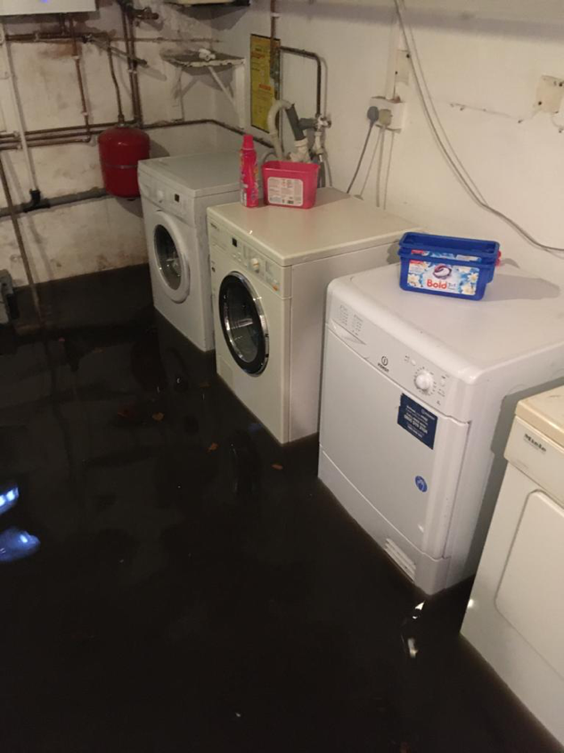
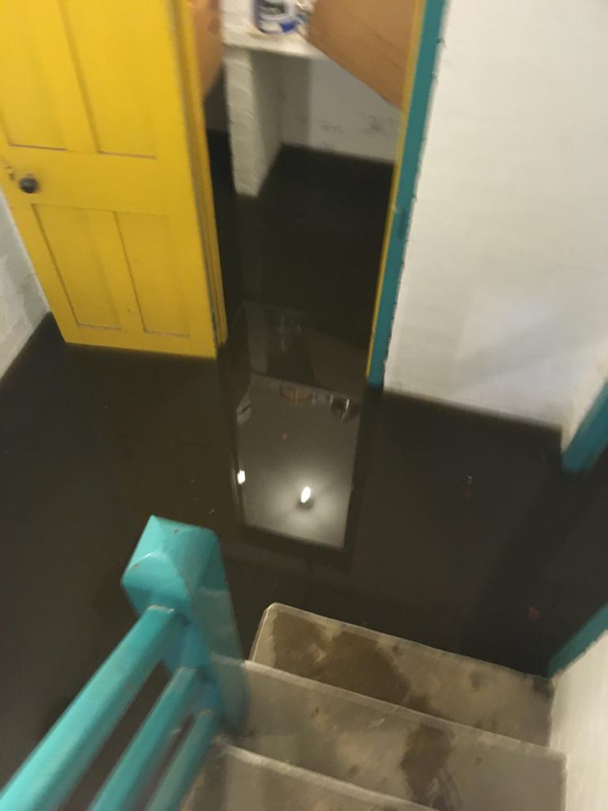
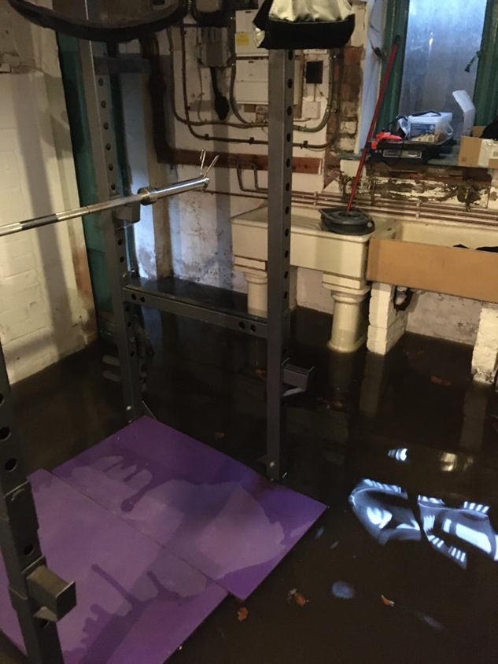
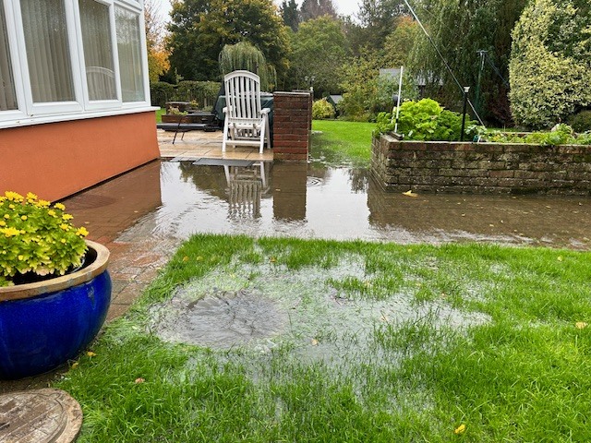
“There was a period of time where probably 2-3 times a year there was a lot of water in the basement- it could be up to my knees at times. At first there was appliances on the basement on the floor, we now have a plinth they sit on. We had to make insurance claims as it killed 2 washing machines and a tumble dryer.”
Multiple incidents, internal, high severity
“Initially it was coming through so fast it was going back down to the kitchen out the conservatory. Essentially the conservatory was filled with diluted sewage and it pushed up the manhole cover in the garage which the fridge and freezers are in there. It wasn't hugely deep but there was enough, and it took cleaning.”
Multiple, external, high severity
“After fitting our new kitchen and utility we started to get water coming into both rooms under the skirting board and units…it was coming into the kitchen constantly every day and we had to mop the water up with towels every hour. The water was tested and it contained effluent.”
Multiple incident, internal, high severity
“For the last 5 or 6 years, I’ve reported at least 50 times the sewer pipes outside. They keep getting blocked, every few months there is another issue…in front of the house there is tissue, excrement and all of that, it stinks. It’s terrible.”
Multiple incidents, external, very high severity

Slide 16
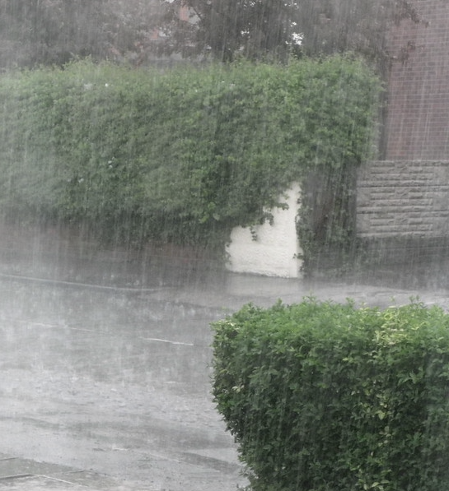
*Alice’s experience
*Alice has experienced recurring issues with overflowing drains causing flooding in her home.
In periods of heavy rain, the sewers on Alice’s street become overwhelmed leading the drain in Alice’s garden to overflow. This pushes out a mixture of sewage and rainwater, which subsequently floods her home. Since she moved in, her home has flooded 5 or 6 times.
Her wastewater company have told her that they are not allowed to spend money on improving facilities in her area, meaning the root problem could not be fixed and the flooding would likely reoccur.
The reoccurring flooding is causing a great amount of stress for Alice, her partner and their 2 children:
Alice’s children wake up in fear during periods of heavy rain, worrying their home will flood again.
The flooding has also had a detrimental impact on Alice’s finances; home insurance has increased so much that her and her family have had to move out and rent out their home to cover the increase. She cannot find anyone willing to buy the property whilst the flooding issue persists, leaving her feeling trapped.
“This is the roof over my kids’ head. I'm still on some calming tablet to this day because I just can't deal with it … Mentally, this has nearly broken me and my family … I just want out. I just I need to move on with my life.”
Alice feels the issue has been passed around between different parties who are unwilling to take any action to resolve the issue. She feels caught in a loop with no support.
*Names have been changed to protect anonymity.

Slide 17
Overall: views on wastewater company services and support
Section Subtitle

Slide 18
Participants from all wastewater companies gave examples of unsatisfactory service, leaving no room for complacency from the sector
Although this research saw reports of positive experiences within each company, at least one customer from each of the companies included in this research reported cases of extremely negative interactions with their wastewater company.
Positive experiences are often limited to those who have experienced one-off, less complex incidents that are relatively quick and easy to fix. Customers with more complex causes and ongoing issues are frequently left behind.
There are significant lessons to be learnt for all wastewater companies included in this research, despite instances of good interactions. There is no room for complacency from wastewater companies in addressing their response to sewer flooding incidences.

Slide 19
Positive experiences predominately come from those who have experienced a single incident with an easy to fix cause
For customers who have experienced one-off flooding incidents with clear and easy to fix causes, wastewater companies are typically quick to fix the issue.
This leaves customers with a more positive overall experience of the customer journey and of their wastewater company more broadly.
“[They] exceeded my expectations... They responded quickly, came quickly, cleared the drain… They were very considerate, helpful and professional.”
Single incident, external, medium severity
“They exceeded [my expectations]... I didn’t think at the time oh I’m entitled to this and that, they just did it, and they were really nice people, which I think speaks for so much – it’s a stressful and traumatic situation. Just having someone empathetic to speak to is great.”
Single incident, internal, medium severity

Slide 20
However, those facing the most impactful flooding incidents are often the worst served by their wastewater company
Those with complex, expensive and ongoing problems report a failure to address the core issue, leaving them exposed to further risk of flooding. This is exacerbated by communication and support that is perceived to be lacking significantly.
These customers are not only facing the severe impacts of flooding incidents, but also feel they have been left behind by their wastewater company. They are facing significant emotional, practical and financial strain, and are in desperate need of support.
“The impact it had on the children was really hurtful, this is their family home, their safe place, which was no longer their safe place… Every time it rained they’d wake up in the night and ask ‘Do we need to put the flood defence up? Is the house going to be ok mummy?’ I’d tell them it’s fine but I’d be sat there watching the CCTV all night waiting for the drain to pop… mentally, this has very nearly broken my family.”
Multiple incidents, internal, very high severity

Slide 21
Those who have experienced multiple incidents say they’ve seen some service improvements, however companies don’t receive praise
A rise in number of participants receiving financial redress
More report receiving case numbers, case workers, and more joined up comms
More examples of follow-up, aftercare and seeking of feedback
Improvements in the tone and level of compassion shown by customer service agents
While appreciated, these improvements are not necessarily credited to wastewater companies’ own initiative. Instead, customers attribute these changes to other factors, such as escalation in their individual cases with the involvement of MPs, or local media raising the profile of specific incidents.
“There seems to be a new strategy, since perhaps 2023 certainly, it's quite different. There’s a customer relations team asking how the experience has been, it's a lot more proactive. It's as if they've been woken up. I would imagine it’s to do with the sewage on beaches, but it is positive.”
Multiple incidents, internal, high severity
“Since December 2020 when we had the big [flooding] incident, service has been a bit more focussed- but otherwise before then, the other incidents it was like they didn't even know, you would say it's happened and they would say ‘has it’?”
Multiple incidents, internal, high severity

Slide 22
These customers are often taking extreme actions to resolve issues, due to lack of support from their wastewater company
Where customers are facing extreme frustration as a result of unsatisfactory responses from their wastewater company, some report escalating their case. This can often be time consuming and expensive for customers, meaning it is viewed as the last resort to try and reach resolution.
Customers have reported:
Taking their wastewater company to court
Reaching out to local MPs for support
Contacting the local media to try to gain attention for the issue
“The local council has an environmental department, so I went to them and asked them to put some pressure on [my wastewater company] to resolve the issue.”
Multiple incidents, internal, medium severity
“I thought, ‘no, I really need to increase the heat now’…we went for a little bit of the nuclear option and had MPs and members of the executive team copied in on certain emails. And guess what? They’re reacted straight away – [it’s about] working out that sort of threshold of noise that then gets you to a point where you're being taken seriously.”
Multiple incidents, internal, high severity

Slide 23
Overall, there are significant gaps between customer expectations and services received
Customer expectations
Customer reality
Customers have high expectations of their wastewater company. They want to feel that their problem is being taken seriously, and that their wastewater company will do what they can to fix the problem, paying for any damage that puts them out of pocket.
In reality, many customers feel their wastewater companies are doing the bare minimum in responding to incidents, leaving them either financially out of pocket, frustrated with customer services, or for some, even causing more emotional damage than the fooding incident itself.
“I had faith they would fix it. It’s their network, they have full responsibility for resolving the issue and putting things right… but no chance.”
Multiple incidents, internal, high severity
“They gave me... Around £150 off the water bill for the inconvenience. I had flies everywhere, it was disgusting. It’s like they’re laughing at you when they offer that. It’s insulting.”
Multiple incidents, internal, high severity

Slide 24
Deep dive: Communication, support, resolution, financial support
Section Subtitle

Slide 25
Four areas have been identified as being key to improving sewer flooding services
Communication
Providing support when things go wrong
Resolution
Financial support

Slide 26
While all areas are of importance, resolution holds the most weight for customers
Communication, providing support when things go wrong, and financial support all play a crucial role in influencing overall customer satisfaction with their wastewater company’s response to sewer flooding. Where customers have good experiences with their wastewater companies in these areas, they are more likely to reflect on the incident more positively.
However, without resolution, even the strongest performance in the other areas will leave customers feeling dissatisfied with their wastewater company.
If this final step cannot be achieved to a satisfactory level, customers can be left financially, emotionally and physically worse off. As a result, this lasting negative impact has the potential to overshadow any previous positive interactions.
Providing support when things go wrong
Financial support
Communication
Resolution
While most customers reported negative experiences across one or all of these areas, this was not universal. A small number of customers reported positive interactions with their wastewater companies, highlighting areas where lessons can be learnt. There are examples on the next few pages.

Slide 27
*Eve’s experience
*Amanda experience
Despite facing a stressful situation, a positive response from *Eve’s water company left her feeling reassured.
*Amanda’s water company’s response to her sewage flooding incident has left her with a lasting positive perception of her water company.
Eve* noticed some water trickling through the walls in her cellar. After her neighbour discovered a blockage in their pipes, Eve realised that this was sewage water and called her wastewater company.
After a period of heavy rainfall, Amanda* woke up one morning to a foot of water flooding the entire downstairs of her home. Water was gushing out of her downstairs toilet.
Although she was highly stressed, she felt that her wastewater company recognised the severity of her situation and acted with care and empathy.
She was quickly able to speak to a representative who gave her a reference number. They visited her home 2 days later, and it took 2 subsequent visits to resolve the issue.
They came out to the property on the same day and one representative even gave her their personal number should she need further assistance.
Throughout the process she found communications from her wastewater company were clear and informative, and staff were always friendly and professional.
She describes her water company’s response as ‘amazing’.
Knowing that they'd explained what was going to happen next made me feel better…I didn't have any problems at all.
“They’ve been brilliant. They knew what we’ve been through already and were very sensitive.”
*Names have been changed to protect anonymity.

Slide 28
*Nia’s experience
*Helena’s experience
*Nia’s experience with her wastewater company has left her feeling reassured that her issue has been resolved.
*Helena was pleasantly surprised to receive financial support following her flooding incident. She feels it demonstrates that the impact of her issue was understood by her wastewater company.
Nia* noticed her downstairs toilet seemed to be blocked, and when she flushed it, it began to overflow into her home. She also noticed dirty water had flowed into her garden.
She called her wastewater company to report the sewage flood.
Helena* came home to find a puddle of sewage in her utility room.
Her wastewater company came out to her house 3 hours later, cleared the blockage that had caused the leak and then cleaned the exterior of her house.
Nia’s wastewater company came out within 24 hours and cleared the blockage before cleaning the garden of any debris. The whole process took a couple of hours.
As she felt the flooding incident wasn’t very severe, she didn’t expect to receive any compensation from her wastewater company, so it was a ‘pleasant surprise’ to receive an initial payment of £300, followed by a payment of £170 a few months later.
Nia is confident this issue won’t reoccur, but feels reassured by her water company’s response should she need to contact them again.
“It didn't take up much of my time. It was within a couple of hours, and they were done…I haven’t had any issues since.”
They were most helpful and polite…it seemed like they cared, like they understood the predicament.
*Names have been changed to protect anonymity.

Slide 29
Communication

Slide 30
Customers are largely positive about the initial interactions – however some problems are reported
Communication
Customers are positive about:
However, they cite problems with:
Initial contact
The accessibility of their wastewater company, with most making contact via the phone, but some using email / online tools.
Quick response times
Professional and empathetic manners from customer service agents
[For a minority of customers only] Knowing that it was their wastewater company they needed to contact. Some initially went to their local council, fire service or a plumber before being redirected to their wastewater company.
Initial visit
The timeframe of initial visits (within 24 hours for most)
The level of knowledge and customer service of call-out teams and/or engineers
A lack of clarity about when visits will take place (e.g. exact times not given), adding to customer unease and stress
“The problem is these days when you ring the helpline you expect people to not care anymore. [My wastewater company] were mostly helpful and polite…it felt like they cared, like they understood the predicament.”
Single incident, internal, low severity
“It was frustrating, trying to get through to them, and not being given updates as to when they're coming out.”
Single incident, external, medium severity

Slide 31
Positivity significantly drops off following initial contact
Communication
Following initial positive interactions, very few customers describe their wastewater company as being proactive at staying in touch with them during or following a flooding event or incident, leading to a strong sense of dissatisfaction. This is characterised by:
“Every time I called, and I referred to a previous conversation, their record wasn’t quite accurate. There was always a new case ID, I always spoke to someone different. There should be a dedicated person, it’s tiring; I did not understand why they always gave a me a new case ID.”
Multiple incidents, internal, very high severity
A lack of updates, where customers have to continuously chase their wastewater company for a response.
Poorly joined-up communication, for example customer IDs not being linked, and no case numbers for most, meaning customers have to repeat their story from scratch each time.
This puts the burden on the customer to keep a chronology of incidents and log of interaction with their wastewater company.
“It's more me chasing them. That's one thing I've really noticed. If they give me a date, I'd expect them to give me a courtesy call or a text or something to say, ‘we're definitely coming out’, but there's just nothing. And then I'll call them asking ‘are you still coming out?’, and they’ll say the job's been deprioritised. So, if I didn't ring, you wouldn't tell me?”
Multiple incidents, external, very high severity
No notice before agents visit the property, often resulting in call-out teams arriving while customers are out.
In some cases this means access can’t be gained to interior floods and visits have to be rescheduled, further delaying the process.
Being provided with incorrect information either from their wastewater company or other organisations.
This can relate to who they need to contact or what they are able to claim, but can also be in regard to their specific incident and its causes/ progress.

Slide 32
For many, a lack of communication is the biggest frustration in the customer journey
Communication
Poor communication leads to a variety of issues for customers…
A perception that there is a lack of empathy
Poor communication makes wastewater company appear unsympathetic or disinterested and places the responsibility on the customer to get updates and ensure progress is being made.
Processes taking longer than they should
Recontacting wastewater companies is often slow and frustrating, made worse by not having a single point of contact, leaving customers to repeat their story each time.
In some cases, customers feel that it is not worth their while to continue where it is felt to require too much time or effort on their behalf to make progress.
This is overshadowed by the feeling that even with this effort, their wastewater company will not help them.

Slide 33
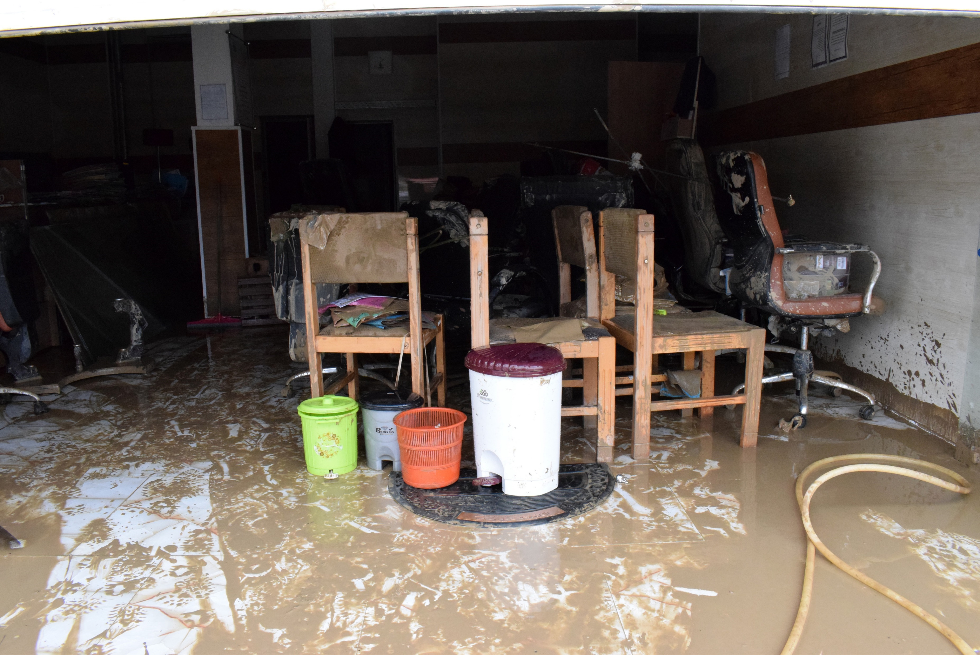
Communication
*Amelia’s experience
*Amelia lives with her boyfriend and their dogs in a basement flat they rent. She experienced a one-off incident, but the impacts of that incident are on-going.
“[Communications] were jumbled or incomplete and didn't make sense. I had a lot of back and forth, lots of disinformation, where correspondence doesn't match what happened on the day. So, when I was going through emails it was really confusing and sometimes case numbers are different; I have 3 different ones for my incident alone.”
Amelia woke up in the middle of the night to find a foot of water flooding her flat. Panicked, they moved out of the flat that night, collecting the belongings they could over the next week.
Amelia reported the incident to her wastewater company, who said they would investigate the cause of the flood.
Over the following months she received confusing and conflicting communications including:
Claiming there were no other issues in the area, although Amelia had seen that her whole road was flooded.
Telling her the debris on her property was from the initial incident, even though she had witnessed ‘mini floods’ each time she had visited her property.
Continuously cancelling scheduled visits, often with very little notice, which was particularly inconvenient as Amelia wasn’t living in the property.
Giving her multiple case numbers for the same incident, making it more difficult for her to sort things out with her landlord and insurance company.
*Names have been changed to protect anonymity.

Slide 34
Communication
For customers experiencing high severity incidents or multiple flooding events in particular, there can be significant communication problems.
“There was really terrible, terrible, terrible communication…it felt like there was a lack of sympathy. It was a huge disruption for lots of people, the whole procedure is painful already, but having to deal with the water company adds another layer to it.”
Multiple incidents, internal, very high severity
“It can be frustrating; the notes they’re taking don’t seem to be accurate, the second person repeats wrong information and I have to correct them. There seems to be some miscommunication within [my wastewater company].”
Multiple incidents, internal, high severity
Multiple incidents, external, very high severity
“Whenever something happened I would report it, and when they finally wrote back they’d say, ‘we’ve mitigated these issues and we’re not going to respond to any more of your messages.’ So that’s when I gave up, I don’t report anything now.”
Multiple incidents, internal, high severity
Multiple incidents, external, medium severity

Slide 35
There have been some signs of improvement since the previous wave
Communication
“I had a case reference number, and I was given a case management team, telephone number and a job number. I was quite pleasantly surprised; someone came around with a metal detector because they wanted to get a better understanding of what went down, and the week or two after the incident I think the woman phoned me maybe 2 or 3 times.”
Single incident, internal, low severity
Whilst interactions with wastewater companies are often described as ‘cold’ they are not considered rude or unempathetic.
The 2022 research found that some customers had experienced ‘insensitive’ or ‘insincere’ behavior from customer service staff. Whilst customer service is an area that still needs to be worked on, there has been some improvement since the previous wave.
A customer care team, who has checked in following the incident.
Assigned case numbers or case workers, making the system feel more linked up.
These improvements have been noted by those who have experienced multiple flooding incidents.
“We were assigned a lovely lady who was so caring and 'on things’. We contacted her a lot, especially after the second flooding. She was amazing and a credit to her company. She put our minds at rest.”
Multiple incidents, internal, very high severity

Slide 36
Customers want clear and proactive communications that set out timelines for action
Communication
Customers outline four ways in which they want to see communication improved:
Clear timeframes for visits: To reassure customers of when a visit will take place and avoid any scheduling issues e.g. them leaving the property when a call out agent arrives. Customers want enforced communication including the minimum amount of notice that should be given (e.g. six hours) and an easy way to reschedule if this time doesn’t work.
Proactive updates: So customers feel well informed, and do not need to make contact themselves. If there is no update to be shared, customers want to receive a holding email to be reassured their issue is still under investigation. Customers also advocate for the use of online portals where they can easily check on progress and see updates from their wastewater company, alongside a history of the documents they’ve received from their wastewater company.
Customers want a clear chain of written communication: To be maintained so that they can see the chronology of their interactions with their wastewater company. Customers are already keeping their own records, but feel wastewater companies make this more complicated (e.g. by starting new email threads).
A single point of contact: This is felt to help prevent the need to repeat their situation each time they get in contact, and instills confidence that someone cares about their situation. However, some customers flag that if their contact is unhelpful in resolving their issue, they feel ‘stuck’ in the system.

Slide 37
Providing support when things go wrong

Slide 38
The offer of a clean-up service is what customers expect as bare minimum
Providing support
Clean-up services
“A clean-up service should be offered – it sounds like some people have received this and others haven’t. It should be standard across water companies, there shouldn’t be that variation.”
Single incident, internal, medium severity
Customers feel that a clean-up service should be provided by wastewater companies to all customers, regardless of customer vulnerabilities or severity of the flooding.
The service should be:
Thorough, with appropriate time dedicated to it.
Ideally be treated as an emergency service, due to the potential health hazards of having sewage in the home.
Available to all, but with vulnerable customers and those experiencing severe flooding incidents being a particular priority.
“We were left with that foul water sitting there for 5 days. If they said no, we're not going to send you a truck, we would have found another truck from somewhere else, you know.”
Multiple incidents, internal, high severity

Slide 39
Whilst a small number of customers note that the clean-up service has improved, for most this service does not go far enough
Providing support
Clean-up services
Some customers are positive about:
However, more cite problems with:
The service arriving promptly.
The clean being thoroughly completed.
Note: This is true only for a small number of customers. These customers are significantly more likely to have experienced external flooding.
Communication, with some not being given a clear time for the visit and having to chase for updates as a result. For some customers, this led to: Feeling forced to begin the clean-up themselves and/or declining the clean-up service, as they preferred to complete it themselves rather than having to wait.
Trusting their wastewater company will believe the severity of the flooding if they begin the clean-up themselves (i.e. as they are removing proof), meaning some feel forced to leave it as is.
The quality of the clean-up service, feeling it was hurried and inadequate, meaning customers have to redo the clean-up themselves.
A small number of customers report not being offered a clean-up service at all.
”Some offer of help of some description, for example help cleaning up, would have been nice.”
Multiple incidents, internal, medium severity
“They said they would get somebody to me within two hours. I hadn't heard anything 2 hours later. I tried to clear it up myself but couldn’t.”
Single incident, internal, very high severity
”[The clean-up team] were there for about 10 mins. I could still smell it, so I went behind [the furniture] myself and was just pulling out lumps and lumps of poo. I can't believe after two deep cleans I am pulling out lumps of poo.”
Single incident, internal, very high severity

Slide 40
Customers also do not currently feel that their individual circumstances are being considered
Providing support
Additional support
Many customers feel that their wastewater company has not made an effort to understand the physical or emotional impact the flooding incident has had on their lives. As such, they feel that:
Wastewater companies need to get the full picture of the incident to provide appropriate support.
In many cases, there is no representative visiting the site of the flooding to assess the situation both in terms of the actual flooding and the household situation e.g., who lives there and if they have any additional needs.
Customers feel this is a necessary step in providing tailored support, starting with understanding who lives in the property and how they are being impacted.
If the specifics of customers situations are not taken into account, responses can be lacking or incohesive.
Some customers have found support offered has been disproportionate to the incident, or simply not well thought through. For example, some customers have had sandbags delivered to help mitigate flooding, however they have been placed inconveniently, meaning customers need to move them themselves and may struggle to do so.
This is also important when it comes to financial support; the lack of someone assessing the situation can be an issue later down the line when it comes to financial support – if no one has surveyed the property, it is difficult to determine how much financial support is required.
In cases like these, where specific needs and vulnerabilities are not considered, customers explain feeling as if they are ‘numbers’ that need to be managed, rather than individuals facing highly stressful incidents.

Slide 41
Although some vulnerable customers have been offered additional services, support is felt to be lacking in key places
Providing support
Additional support
“We’ve got young children at home; we were worried they would get ill…we weren’t offered any clean-up…We don't use that bathroom any longer. It makes you feel unclean in your own house.”
Single incident, internal, medium severity
There are some examples of wastewater companies providing additional support for vulnerable customers. These include:
Being assigned dedicated case workers, who act as a regular point of contact and understand the case.
Offers of temporary accommodation.
“[My brother] has a [long-term health condition], so he’s very vulnerable. He has to be blue lighted to hospital if he has a health issue…[His wastewater company] covered the electricity bill for the dehumidifier which was around £600, plus a stay at a pub when he couldn't stay in his house.”
Multiple incidents, internal, very high severity
However, this support is not felt to go far enough, and in some cases is not offered at all.
For example, some customers with young children and customers with long term health conditions such as Crohn's disease report being offered no clean-up service, leaving them worried about their or their children’s health.

Slide 42
Providing support
“My wife has severe mental health issues – she got down on her hands and knees and cleared it up before they got there, and as a result they said it was a private issue. Even though we have lots of photos and videos the area manager said under no circumstances will they accept liability .”
Multiple incidents, internal, very high severity
“They definitely did not offer a clean-up service. And haven't throughout the entire process… When I kept saying things like, 'there's mould coming through,' they said you should clean that up as if they weren't responsible for any of it."
Single incident, internal, high severity
Multiple incidents, internal, high severity
“A week or so later when I was moving things, there was still clumps of dried toilet paper...When I moved the washer there was a load of dried toilet paper with mess behind it.”
Single incident, internal, very high severity
Multiple incidents, external, high severity

Slide 43
Providing support
*Lucy’s experience
*Lucy was left living in a property with sewage and no working toilet, and received no support for finding alternative accommodation. Due to the mental strain of dealing with the flooding incident, she has now moved out of her basement flat.
Lucy was working from home when she heard a loud bang from her bathroom; water was gushing out from her toilet, covering her bathroom, kitchen and lounge.
She went outside to investigate and someone from her wastewater company was on the road jetting water into the drains. When she told him what had happened, he was very apologetic and told her he must have jetted the water the wrong way. He assured her the wastewater company would send someone out within 2 hours, and would compensate her for the damage. Although he was ‘nice’ and reassuring, the support Lucy received from her wastewater company afterwards was lacking:
Lucy was waiting a long time for support; she waited 29 hours for someone to arrive at her property, at which point most of her belongings were unsalvageable.
Whilst waiting for support to arrive, Lucy received no updates from her wastewater company that their arrival time had been pushed back, meaning she had to chase them for updates.
“It wasn't the incident itself, it was how it was handled that was so upsetting. They didn't come after two hours so I had to chase them, and after that people were horrible. I was signed off for two weeks with stress. I’m not somebody who struggles with their mental health, I’ve never had that.”
They spent 30 minutes cleaning Lucy’s property; when she checked behind her wall a couple of days later, she found there were still lumps of sewer.
Lucy asked for support in finding alternative accommodation, which was not offered. She felt her wastewater company didn’t take her seriously.
*Names have been changed to protect anonymity.

Slide 44
Customers want to see evidence that their wastewater company is considering the full spectrum of needs
Providing support
Customers outline four ways in which they want to see support improved:
Understanding the full scope of the situation: Customers want the specifics of their situation to be considered by their wastewater companies. A consideration of who lives in the property (and their needs), what their financial situation is, and extent to which they have a network to support them is felt to be important alongside the severity of the flood.
Better assistance for vulnerable customers: For example, customers with children and customers with long term health conditions might require more support, such as moving into temporary accommodation, if the flooding causes changes to the way the house can be used (i.e. the kitchen being out of use while repairs are carried out). Wastewater companies should take into account the specific vulnerabilities of each customer, rather than a blanket offer of assistance.
A thorough clean-up service offered to all as standard: Customers feel that all those who have experienced a flooding incident should be offered a clean-up service, regardless of their vulnerabilities. The service should be thorough and conducted shortly after the incident, at a time convenient to the customer.
Useful support through thoughtful communication: While wastewater companies are addressing the issue, customers want to be offered additional support, for example, signposting of external help and services available (such as local facilities for showers or health advice) active communication about their issue and the specific support they are being offered, and interactions with staff in customer facing roles (aside from engineers or call out agents) to address the emotional impact of the situation.

Slide 45
Resolution

Slide 46
Customers view resolution as incorporating four key actions…
Resolution
Fixing the root problem
This is the number one priority for customers in achieving resolution. Due to the emotional, physical and financial impact of a flooding incident, customers want reassurance that the problem will not reoccur. Where wastewater companies won’t agree to do this (i.e. the problem is too complex or costly), customers want support from them in finding other ways to protect their home
Financial support
Whilst of secondary importance to fixing the problem, customers want to see their wastewater company reimbursing any costs they have incurred as a result of the flooding incident with some also wanting to receive money for their inconvenience and emotional damage (covered in depth in the next section).
Fixing home damage
The impact of a flooding incident can create significant damage to customers’ properties can require expensive renovations or even displacement. Customers want to see their wastewater companies providing support for these challenges.
An apology
Many customers want recognition from their wastewater company of both the physical and emotional damage that a flooding incident has created, particularly if they see their company as responsible for the flood.

Slide 47
…However, few feel their wastewater companies are providing resolution in any of these areas
Resolution
Fixing the root problem
A significant proportion of customers, particularly those who have faced multiple issues, report the root of the problem not being fixed, putting them at risk of further flooding. This can significantly contribute to emotional pressure such as anxiety, especially around times of heavy rainfall, as well as significant financial strain.
Financial support
The majority of customers are dissatisfied with the level of financial support received, if any.
For most, the level of financial support is insufficient to cover the costs incurred by flooding incidents, and fails to consider future costs such as increased home insurance. This is particularly true for those experiencing multiple incidents, who report investing heavily in preventative measures.
Fixing home damage
Few customers report their wastewater company providing support (financial or otherwise) in repairing home damage. For those who do, they report having to fight hard to receive any assistance.
An apology
Few customers report receiving an apology, with many speculating that their wastewater company is reluctant to do so, in case this risks implying liability for the flood itself. There is a sense that through denying liability, companies can avoid reputational damage, as well as paying for the full cost of damages incurred to customers.

Slide 48
Customers often see resolution as hard to reach, with some giving up on trying to achieve it
Resolution
Customers report having to push hard to make progress towards resolution:
This may mean carrying out extensive research (such as on their local drainage systems) or consulting with specialists to understand the issue, in order to put pressure on their wastewater company.
This often becomes a huge time commitment for these customers, with some likening it to a ‘full-time job’.
This is often the case for those experiencing multiple incidents as these customers feel they have more to lose (i.e. financially, emotionally) by not having the issue resolved.
However, other customers describe a sense of resignation in trying to achieve resolution:
This is particularly true for those experiencing single incidents, where customers report feeling emotionally drained by the incident and earlier stages of the customer journey.
They describe feeling like they have little energy to fight for resolution in any form, instead wanting to move on from the situation.
This can lead to customers shouldering costs for damages, and lacking reassurance that the issue is fixed.
“I rang them again the next day and was told they would escalate it but nothing happened. I called them the following week and threatened the press, citizen's advice etc.- then I got a call from a manager straight away.”
Single incident, internal, very high severity
“I've chased them over months, it makes me look crazy or like you're stalking them… Eventually I gave up. I thought ‘I won’t interact with these people anymore’.”
Multiple incidents, internal, high severity

Slide 49
This lack of ability to achieve resolution can keep customers stuck in a cycle
Resolution
Without resolution, customers are often left to continuously chase their wastewater company, keeping them stuck in a cycle in the customer journey. This can serve to further exacerbate and prolong issues around communication.
For many, this creates a significant point of tension in the customer journey, leaving customers with a lasting negative perception of their wastewater company.
Communication
In some cases, customers report a view of their wastewater company diverting the responsibility to another organisation (i.e. the council). In these cases this cycle is even further elongated, where no party willingly takes responsibility, and therefore no action is taken. These customers report significant frustration and disempowerment about their issue ever being resolved.
Financial support
Providing support when things go wrong
“It's just like they're not really solving any problems. They're always polite and pleasant and responsive, but at the end of the day, the problem hasn't been resolved. They gave me a letter stating they're not going to do anything about it…I just want the matter to be resolved. They did send me a basket of flowers, but that doesn’t make it any less stressful for me.”
Multiple incidents, external, medium severity
“When the council passed the job to [the wastewater company], they left a mess. They said because it’s [the council’s] pipe, they should come and clean-up. When I phoned [the council], they said ‘no, [the wastewater company] did the job so they should come and clean up’…I have a kid living inside, what do you mean?... I'm trying to push for the issue to be resolved, but I'm afraid they're just going to say, it's not our pipe, not our problem.”
Multiple incidents, external, very high severity
Resolution

Slide 50
Resolution
“It’s not resolution if they just try to keep me quiet… Resolution would be liaising with the highway to find out the real problem…”
Multiple incidents, external, medium severity
Multiple incidents, internal, high severity
“I don't think they've done enough. They put cameras down and all that kind of stuff, but I don't think they've done a proper thorough job on it to actually really address the issue."
Multiple incidents, external, very high severity
Multiple incidents, external, medium severity
"You feel like they think that you're making it up, or you're trying to drag it out. And there's nothing we want more than to have this issue finished so that we can just move on.”
Single incident, internal, high severity
Multiple incidents, internal, high severity

Slide 51
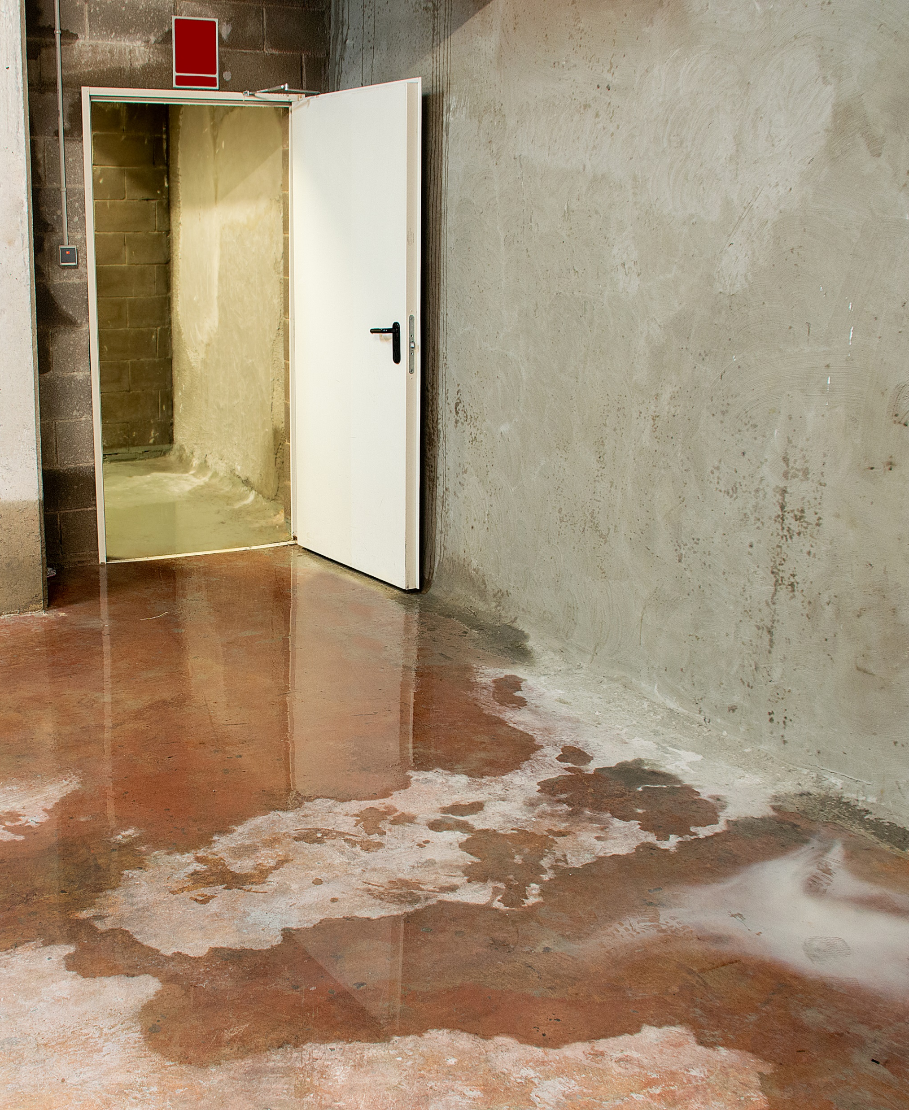
*Steven’s experience
Resolution
*Steven lives with his wife and two daughters aged 11 and 13. He has experienced multiple internal flooding incidents since he bought his house in 2016.
Steven first noticed the flooding in his basement shortly after he bought his house. After realising the flooding was sewer water rather than freshwater he reported the issue to his wastewater company, who came out to investigate.
Since then he has experienced a couple of flooding incidents each year, usually around times of heavy rainfall. He has started pushing hard on his wastewater company to fix the issue, but has made little movement towards resolution:
Steven has constantly had to chase his wastewater company for updates on his situation, often emailing multiple times in a row before receiving a response.
“They sent me an email that said ‘As we've answered all your concerns, you've reached the end of our complaints process. If you contact us again about our mitigation against flooding incidents around your property, we won't reply, as there's nothing further, we can add’. So I responded saying no, you’ve not, but then they’ve ignored that.”
He is highly concerned about whether he will be able to sell his house down the line if his issue is not resolved. He feels that his wastewater company has no sympathy for his situation.
After continuing to put pressure on his wastewater company to fix his issue, he received an email to tell him they will no longer respond to any communications about his case.
Having received financial payment once, he has otherwise been told he is not eligible for further payment.
*Names have been changed to protect anonymity.

Slide 52
Customers want to see wastewater companies go further in providing a resolution post incident
Resolution
As noted, fixing the root problem is the key priority for customers. However, customers outline four further ways in which they want to see resolution improved:
Communicate transparently: Where the cause of the flood may not be quick or even possible to fix, customers want clear, transparent and proactive communication from their wastewater company on any potential solutions and updates on progress, to be reassured that their problem is being addressed.
Offering support: Particularly whilst the issue is being fixed, such as sandbags or dehumidifiers, to prevent or limit any further damage from occurring.
Broader preventative measures: Customers perceive drainage systems in the UK as outdated and ineffective. They want to see their wastewater company considering long-term solutions for how sewer issues can be prevented across the UK in the future.
Clarity on how to escalate their claim: Customers want to understand the roles that Ofwat and CCW play, and what role or support they should expect to see from them.

Slide 53
Financial support

Slide 54
Financial support
Positively, many more customers report receiving some level of financial support compared to research in 2022
Almost all customers report receiving some level of financial support from their wastewater company:
For most, this is in the form of a rebate on water bills. This is likely part of the Guaranteed Standards Scheme (GSS), however most customers indicate no awareness of this.
Those who have experienced multiple flooding events within the same year often get one rebate per year, rather than a payment for each incident.
A small minority report receiving more substantial financial payments towards home repairs.
For some a rebate is applied automatically without customers having to apply for it. For those who have experienced multiple flooding incidents, they point to this becoming automatic within the past 2 years.
However, others report needing to apply for financial support. In some cases, customers need to put continuous pressure on their wastewater company and provide evidence of the flood and its damages in order to receive it.
“We get rebates on the bill, our sewer costs. For the last 2 fiscal years we've effectively had our water paid for. We may have had to apply for it in the past, but now it happens voluntarily. It seems to be automatic.”
Multiple incidents, external, high severity
“They said I didn’t send them anything under the customer guarantee scheme, which guarantees payment for internal flooding. So instead they just sent me £90 as a gesture of good will.”
Multiple incidents, internal, very high severity

Slide 55
However, the level of financial support offered to customers is broadly considered to be unsatisfactory
Financial support
For many customers, the cost of a sewer flooding incident can be significant, reaching thousands of pounds and more. Costs incurred often include:
Due to these costs associated with flooding incidents, the financial support in the form of a rebate on water bills is often considered to be insufficient and unsatisfactory.
Customers do not view financial support as a means to cover the costs of the damage, but rather as a ‘good will gesture’ or way to keep customers quiet to avoid further complaints.
Products: e.g. white goods, sofas
Repairs: e.g. new flooring, redecorating
Prevention measures e.g. sandbags, towels, plumbing
Increases in home insurance
Decline in valuation of property
“‘[My wastewater company] said they would give me £150 as that was my annual sewer charge. I was getting quotes for £4,000 - 5,000 to get the damage fixed from the flooding - furniture, plumbing etc. It felt so unfair as none of it was my fault.”
Single incident, internal, high severity
“So far it’s cost us £11,000, and that's just on replacing belongings, not even doing work. The work as well is about £20,000. It’s replacing all the appliances - fridge, freezer, oven, washing machine, tumble dryer, kitchen units, the kids’ toys, tv units, then the sofas were £3,000 alone.”
Multiple incidents, internal, high severity

Slide 56
Financial support
“It was resolved physically and technically, but financially only partially. I'm fortunate I'm in a position where it didn't have a huge impact, but others may not have been as fortunate.”
Single incident, internal, medium severity
“I don't know if I should have pursued further or not, but to be honest, I thought it would've been a waste of time…Just by the way the lady spoke on the telephone, it was as if 'case-closed, we won't compensate.’”
Single incident, internal, very high severity
Single event, internal, very high severity
Multiple incidents, internal, very high severity
“I didn't have personal contents insurance so I'm screwed, like I don't have a bed frame, I have loads of out of pocket expenses, I'm hoping down the line I can claim against them legally.”
Single incident, internal, high severity
Multiple incidents, external, high severity

Slide 57
Financial support
*Sarah’s experience
*Sarah is retired and lives by herself. She has been experiencing ongoing flooding for the past 5 years.
Whenever there is heavy rainfall, the sewer system on Sarah’s street backs up, forcing sewer water into the houses in the local area. Whilst her house does not get flooded, the sewer water gets into the walls of her house, creating a problem with mould and damp throughout the house.
Every time this happens Sarah reports it to her wastewater company. She finds them responsive and helpful, until it comes to financial compensation:
Sarah usually receives one-off rebates on her water bills after a flooding incident. This is usually of about £65.
Having had to redecorate twice and replace floors damaged by damp, Sarah is about £9,000 out of pocket.
Her wastewater company refuses to cover the cost of repairs, saying it is not their obligation. She finds this extremely frustrating as she knows she is not responsible for the flooding.
“They have given me some compensation, not compensation, they give me some money off my bill twice every six months. They gave me something like £67. I don't want that. I just want the problem to be solved. And they did send me flowers once. It’s a joke. They’re a joke.”
Last year Sarah’s wastewater company sent her flowers as an apology. She found this insulting.
*Names have been changed to protect anonymity.

Slide 58
Customers want to see financial support go further in contributing towards the full scope of costs incurred
Financial support
Customers outline four ways in which they want to see financial support improved:
Understanding the impact of damage: Customers want to see wastewater companies carrying out thorough inventories with customers. Customers want to see wastewater companies assessing the full scope of customers’ circumstances, such as living situation and additional needs.
Covering the costs of any replacements and repairs: Such as any damages or losses incurred by customers.
Guidance and information around financial support: Including any additional support available for both vulnerable and non-vulnerable customers. This should include references to GSS, making customers aware of whether they need to take action in order to receive money, and clearly signposting and proactively offering support to customers.
Ongoing support for those facing long-term consequences: For those dealing with issues such as impacts on property price or costs of rising home insurance excesses, customers want their wastewater company to go further in contributing towards costs more widely (e.g. through covering the difference in increased insurance costs).
58

Slide 59
Appendix
Section Subtitle

Slide 60
Sample (full details)
61 customers across England and Wales who have experienced sewer flooding since January 2023
27 male
34 female
55 White British/ White European
4 Asian/Asian British
2 Black / African / Caribbean / Black British
47 belong to SEGs ABC1
14 belong to SEGs C2DE
19 on the Priority Services register
9 with a child living in their home aged 0-3 years old
2 digitally disengaged
56 own their home (with or without a mortgage)
4 renting privately
1 renting from a local authority housing
10 aged 18-34
20 aged 35-54
20 aged 55-69
13 aged 70+
21 very high severity
20 high severity
17 medium severity
3 low severity
*
7 Anglian Water
6 Northumbrian Water
5 Severn Trent Water
6 Southern Water
5 South West Water
5 Thames Water
6 United Utilities
7 Welsh Water
4 Wessex Water
8 Yorkshire Water
38 internal flooding
23 external flooding
24 single incidents
37 multiple incidents
* Severity was self-defined by customers.

Slide 61
Thank you!
abarker@thinksinsight.com
jsummers@thinksinsight.com
jcohen@thinksinsight.com
mjefferies@thinksinsight.com
oodwyer@thinksinsight.com
Thinks Insight & Strategy
West Wing
Somerset House
London
WC2R 1LA
United Kingdom

