Slide 1
Research into incident response
June 2023 water supply interruption in the South East Water region
Report for Ofwat/CCW – November 2023

Slide 2
Contents
Contents
2
 | Background, objectives and method
 | Summary of findings
 | Customer experiences of the incident
 | Company communications
 | Support during incident
 | Support after incident
 | Conclusions
1
2
3
4
5
6
7
Photo by Jacek Dylag on Unsplash

Slide 3
Background, objectives and method

Slide 4
Context of wider research programme
4
Blue Marble was commissioned by Ofwat and CCW to conduct research with household customers to understand their experiences when incidents take place. The research is primarily focused on water or wastewater-related incidents that affect people in their homes or gardens, or going about their daily lives. The programme will generate findings which:
1
Help to better establish what customers’ expectations of companies are when incidents occur and how well these expectations are met
2
Can be used by Ofwat and CCW to improve companies’ responses and management of incidents and people's experiences when incidents take place
3
Support Ofwat’s wider regulatory work and inform CCW’s wider work on behalf of consumers
This report is the first within that programme of work. More information on the project is available at: https://www.ofwat.gov.uk/customer-insights-when-things-go-wrong/.

Slide 5
Objectives for this project
5
The overarching goal of this long-term research programme is to better establish what customers’ expectations of companies are when incidents occur and how well these are met.
The objectives for this specific project (the first in the programme) are as follows:
1
Understand the views, experiences and expectations of affected South East Water household customers following the June 2023 supply interruption incident, including views on South East Water’s speed of response, support, communication, compensation and overall resolution
2
Determine any differences in the expectations and experiences of different customer groups affected by the incident
3
Identify what parts of South East Water’s response to the June 2023 incident worked well and what could be improved

Slide 6
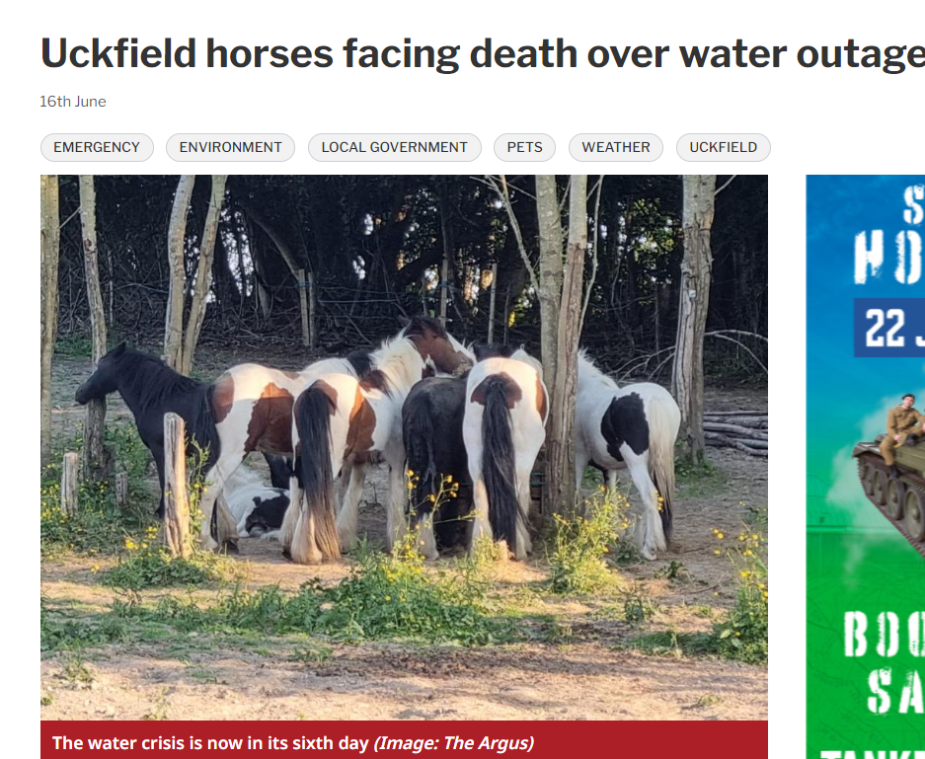
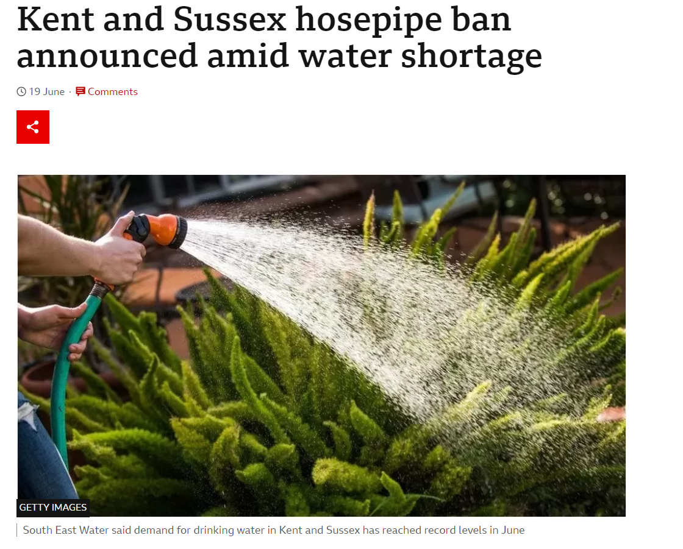
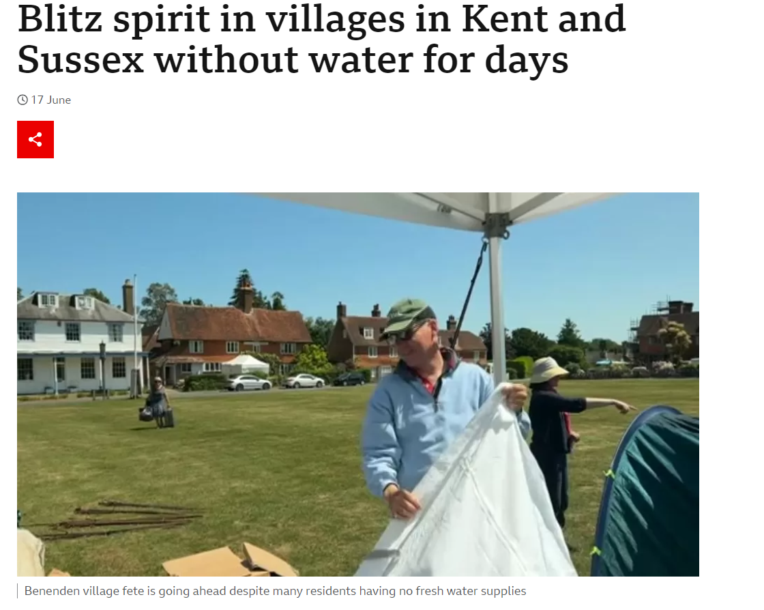
Introduction to the incident we explored
6
Ofwat and CCW received complaints directly from South East Water customers about supply issues they experienced in mid-June 2023. Ofwat and CCW chose to focus on these issues as the first part of the new research programme on incident response.
The incident explored:
In mid-June 2023, thousands of residents in the South East of England experienced supply issues including no water, intermittent supply or low pressure
Some residents experienced issues for a number of hours, for others it lasted for days, even up to a week
There has been significant media attention on the impact of the interruption, focusing on issues such as schools and businesses that had to shut, care homes sending residents in vulnerable circumstances to stay with relatives, and reports of animals in danger of death by dehydration
The outage was due to hot weather and high levels of demand. In response to the increased levels of demand, South East Water subsequently announced a hosepipe ban for Sussex and Kent which came into effect from June 26th and was lifted on the 4th of August
Please see the appendix for a timeline of the incident based on information that was shared with regulators at the time of the incident.

Slide 7
Method overview
7
We conducted qualitative research with 43 household customers from affected areas within the South East Water region, to understand customers’ experiences first-hand. Fieldwork was conducted online and via telephone.
5 x 90-minute focus groups
Financially vulnerable, child-free households
Financially stable, child-free households
Households with children under 7 years
Households with dependent children 7+ years
Households in vulnerable circumstances
Customers were purposely recruited to include a range of experiences and perspectives on the incident:
Length of disruption – from 12 hours up to 1 week
Extent of disruption – all were affected at their own home, with some also affected at work, at children’s schools/nurseries or at the home of someone they care for
Priority Services Register* (PSR) status – including some who reported being on the Priority Services Register
Access to transport – we recruited some customers who did not have access to a car
Billing status – including some who were not billed directly (e.g. water supply is in landlord’s name)
For further information on the sample, please see the appendix.
12 x 1-hr depth interviews
5 complainants
3 digitally excluded customers
4 customers in vulnerable circumstances
Pre-task: All participants asked to complete a short pre-task, which included 3 questions about their experiences of the incident.
Participants were given the option to respond to this via video message, online survey or assisted telephone call.
*Priority Services Register is a scheme which provides enhanced services to those who might need extra support, such as braille bills, or increased warning ahead of planned works. (https://www.southeastwater.co.uk/help/priority-services/)

Slide 8
Summary of findings

Slide 9
Key findings
9
1
Almost all participants were disappointed by South East Water’s management of the June incident – they said the company had not learnt from previous incidents. Participants believed that the handling of the incident made the experience worse for residents. This led to feelings of frustration and, in some cases, anger, and a loss of trust in the company.
Participants reported the company's communication with them was poor. They wanted the company to be more proactive in telling them about the supply problems, and more open and honest in the information they did provide (for example, restoration timeframes). Better and more accurate information would have helped them plan and manage during the incident. Participants were frustrated and this was exacerbated by the tone of some of the communications.
2
3
Most participants did not feel supported by South East Water throughout the incident – they did not feel the alternative water provided was sufficient to meet their needs. Water stations were viewed as being not well publicised, hard to access and chaotic. Water deliveries felt sporadic and unpredictable, and therefore not as helpful as they could have been.
4
Vulnerable customers, including those who reported being on the Priority Services Register, had mixed experiences of the incident. Some received water deliveries from the company, while others, who believed they had registered for extra help, did not get water delivered. Very few participants were contacted by the company directly with an offer of support.
5
At the time of the fieldwork (July – August 2023), very few participants reported hearing from South East Water since the incident. Only a few had received compensation, and numerous participants had been told by the company that they were not entitled to compensation.

Slide 10
Customer experiences of the incident

Slide 11
Water supply problems in mid-June had a significant physical and mental impact on participants
11
Types of issues experienced:
During recruitment we made sure that we had a spread of different types of interruption experience within the sample
Some participants had very low pressure for extended periods, intermingled with periods of no water (or restoration of supply for very short periods). Some were without water for short periods of time, but repeatedly
In the most extreme cases, participants were without water for extended periods (up to six days)
Beryl, health vulnerable (autoimmune disease), not on PSR as unaware of the service:
Beryl’s water supply was intermittent for seven days. She had to get water from the school where she works, and shower at the gym as well as not flushing the toilet.
Beryl has an autoimmune disease that means she needs to drink a lot of water to hydrate and keep her mouth moist. On the first night of the interruption it was too late for her to buy water, so she had to drink cola instead.
Beryl had no texts or communication with South East Water.
“I felt that I was a bit in the dark at times.”
Furthermore, she didn’t know about the PSR. Whilst she didn’t expect to receive any support during the interruption, she told us that she would have benefitted from a delivery of water.
“[The Priority Services Register] would have helped me in terms of being able to… medicate and use water when I needed water, that sort of thing.”
There were numerous impacts on customers’ lives, and those in vulnerable circumstances experienced the impact more severely
Physical impact:
During an interruption, it takes time and energy to:
Stay hydrated
Stay hygienic, e.g. being able to flush the loo, shower
Cook
Keep up with laundry
Mental impact:
Uncertainty about interruption length
Concern about staying healthy/ hygienic
Mental burden of resolving issues (e.g. locating alternative water)

Slide 12
Everyone found it hard to cope – with participants in vulnerable circumstances finding it particularly difficult
12
Examples of participants’ typical coping mechanisms during the supply interruption
Using water/facilities at alternative locations:
Staying with a friend
Staying at a hotel
Eating out to avoid washing up
Showering at the gym
Alternative toileting (forest/dog bags in extreme cases)
Changing routines around hygiene:
Waterless washing and cleaning (baby wipes, hand sanitiser)
Cleaning self/clothes/house less often than usual
Avoiding washing clothes, using laundry services, or taking washing round to friends and families houses
Finding alternative water supplies:
Buying water at a supermarket
Collecting water from an unaffected friend/relative
Getting water delivered
Going to a water station
“Simple tasks that you don’t really think about become quite a challenge… something that you have to organise.” Complainant, 5-day interruption
For participants in vulnerable circumstances, it was harder to access these typical coping mechanisms
Routines around hygiene and hydration were particularly important for some participants in vulnerable circumstances:
Staying hydrated key for elderly, pregnant, certain health issues
Staying hygienic a top priority in households with young children, incontinence, the immunocompromised
Some found it harder to find alternative water:
Expensive
Requires mobility or transport (the latter also has a cost attached)
Requires social links with friends or relatives unaffected by the interruption

Slide 13
Frequent supply interruptions in this area meant customers were more frustrated
13
In the affected region, participants expected problems with their water supply as a matter of course.
Interruptions had been a recurring issue over the last few years and are rarely a one-off – almost all respondents were aware of this from media coverage/experiences of people they know
Many respondents had also experienced multiple issues themselves (with the Freeze-Thaw event in December being most common) – there was low confidence that mid-June interruptions will be the last ones experienced
Participants’ experiences of individual incidents (like the recent June issues) were subsequently viewed through a lens of deeper frustration.
Each new interruption was interpreted as evidence that South East Water was not doing enough to address the issue. Participants’ sympathy was low as interruptions felt less like a ‘one off’
Some participants felt compelled to take the issue ‘over the heads of South East Water’ to see changes in how supply interruptions are being dealt with.
For example, by writing/signing petitions, speaking to media outlets/local MP/parish council/CCW/Ofwat, making official complaints
Case study: Wadhurst – a community worried by the possibility of future interruptions:
Some participants in Wadhurst mentioned a public meeting in July where they were told there was no guarantee that a similar interruption wouldn’t happen again
While pleased at the presence of the company CEO, they were incensed that ‘nothing was being done’ to prevent interruptions recurring
“The senior people at South East Water don’t want to talk to us.” Complainant, 5-day interruption
“I think it will happen again….since this incident, I'm not confident in them.” Dependents aged 0-7, 7 day interruption

Slide 14
Dissatisfaction with how the incident was managed led to feelings of frustration, anger and lack of trust
14
When asked to rank how well South East Water handled the interruption on a scale from 0 to 10, almost all participants gave a score of 4 or less.
When asked to name one thing that South East Water did well during the incident, some participants struggled when thinking of an answer and others reported ‘nothing’.
Almost all participants expressed a complete lack of confidence in South East Water when asked how effectively they think South East Water will handle future incidents.
Participant scores consistently showed that people did not believe South East Water had handled the interruption well. In general, the longer the interruption, the lower the score.
A few had weak positive feelings towards:
The fact that the interruption ended (especially for those experiencing short interruptions)
Direct interactions with frontline members of South East Water’s staff. In a small number of cases, those who had such interactions reported their customer service staff provided positive experiences amidst a difficult situation (although many also reported logistical problems with the provision of water stations)
Compensation (for those that received it)
Most were frustrated with the communication and support provided – this has not improved between incidents (for those who experienced multiple)
A few were slightly optimistic about this research project – they want to make sure that South East Water learns from its mistakes
Disappointed participants said that drastic change is needed to make South East Water fit for purpose, e.g. replacing the management team, stronger regulation
“I'm going to have to give them a 0, because they did nothing.” Complainant, 5-day interruption

Slide 15
Case study: extended interruption and personal circumstance limiting ability to cope
15
Linda* is 63, retired, and lives in a village with her husband. She was without water supply for a week, but left to travel to a second home after four days, as she felt unable to cope.
SEVERITY: VERY HIGH
The respondent felt completely unable to cope and subsequently left the house.
Linda received £250. This was taken off arrears she already had due to incorrect metering, and so didn’t feel like ‘real compensation’. The email communicating this stated that the interruption was “due to hot weather”, a fact she contests. Linda wants to cancel her direct debit, and only pay her bill when she receives water.
Texts and emails that Linda received from South East Water lacked information about support available, and the timeline on the daily texts she received was pushed back by 24 hours each day. Linda also told us that residents were speculating about the cause of the interruption on social media due to a lack of information.
Time
The interruption (Linda’s third since 2020) began a few days after her mother’s funeral – she felt too overwhelmed to look at the website for more information – and so was reliant on direct communication from the company.
Linda coped by buying
bottled water (with a water station only set up 2-3 days into the interruption) and going to the toilet in the garden/using dog bags, as she felt it was more hygienic than being unable to flush the toilet. She found the situation increasingly stressful, and so left the property.
“A lot of people were just speculating, some… saying, I’ve just seen a massive water leak… I’m guessing it’s that, we had all sorts of people making suppositions about what might be going on, but we couldn’t find out what was actually going on.”
“I couldn’t cope, which was why after four days, I think it was, I said I can’t stand this, it’s really making me feel ill, the stress of it all, so we just went.”
“The anger and the outrage are beyond belief, quite rightly so.”
*Names have been changed.

Slide 16
Company communications

Slide 17
Participants reported that direct communication was sporadic, lacking key information which would have helped them to cope with the interruption
17
Email/text
Text and email communications were seen as sporadic, even amongst those who were certain they had signed up for them
Most were initially unaware at the start of the incident of the opportunity to sign up for instant alerts – they would have appreciated clearer signposting
Some households on PSR received notifications, however this was not consistent
The content of messages and emails wasn’t seen as adding value – being limited to repeated ‘spam’ like messages that ‘the water is off’
The tone was felt to be unsympathetic or robotic – messages were not personalised to individual circumstance
Some texts/emails lacked resolution timelines – which were seen as key in coping effectively with the interruption
Others had timelines that were pushed back by 24 hours each day – this was a frustrating, repetitive ‘let down’, and prevented effective coping mechanisms e.g. deciding whether to stay with friends
“It was just a robot text, it meant nothing.” Complainant in vulnerable circumstances (elderly), 5-day interruption
“There was one which said ‘use water sparingly’. A number of people got that one throughout the week, which was… like a kick in the teeth.” Complainant, 5-day interruption
An email from South East Water’s CEO announcing the hosepipe ban left a memorable negative impression
Being asked to ‘use less water’ when supply was interrupted was felt to be insensitive and irritating
A few noted that South East Water apologised for the interruption
For most, this apology was overshadowed/forgotten in light of a perceived ‘shifting of blame’ for the interruption onto customers (through explanations around increased working from home)

Slide 18
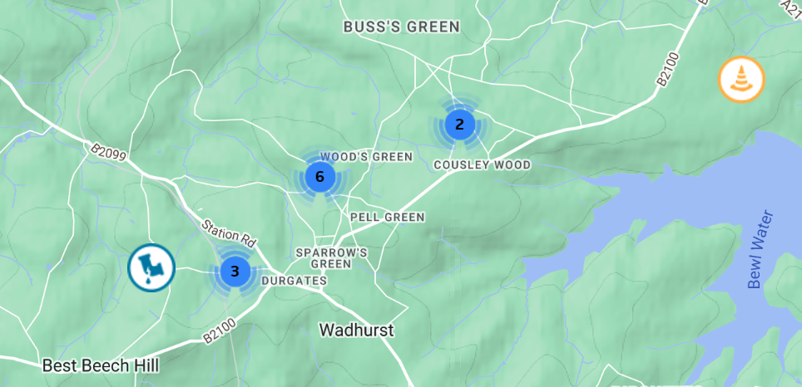
Many proactively sought information from South East Water’s online resources, but found these unhelpful
18
Website
Participants using the website found an interactive map showing the service status in their local area, and that they could register to receive automatic updates via text or email.
However, many reported that updates were not consistent, and most information on the website was updated more slowly than information from local councils on social media
For some, the automatic alerts were the only communication they received from the company
Participants also reported that the content of the website lacked meaningful information, such as the cause of the incident and when their supply will be restored.
Emergency assistance information for those who may have needed specific help was also hard to find on the website.
Social media accounts
The company’s social media accounts were frequently mentioned by participants as a resource to learn more about the situation due to the lack of support from other channels.
Customers felt angry that the tone of voice of South East Water’s twitter posts seemed to be inflammatory, and they did not find much helpful or clear information
Many others did not follow the company on Twitter or Facebook

Slide 19
The experience of speaking to a member of frontline staff was mainly positive though didn’t always help the customer
19
South East Water’s telephone helplines
The small number of participants who decided to give them a call directly reported largely positive interactions.
There were mixed experiences of how easy it was to talk to staff – some got through surprisingly quickly while others found it hard, having been put on hold for long periods of time
The frontline staff answering the call were said to be “lovely”, being very apologetic and understanding of their experiences
Some participants, especially the elderly, would have welcomed more direct interaction, such as door-to-door contact/leaflets
Despite this, the conversations were not always fruitful, as sometimes the staff were not able to provide further useful information on the situation.
In a few extreme cases, the operator was not aware of the interruption in their area
Investigations and support promised over telephone were not followed up – customers waited and tried to follow up, but some never received a callback which left them feeling deeply frustrated
“I think they did answer it straight away, took all my details and the person I spoke to was very pleasant.” Complainant, 7-day interruption
“I was waiting on the phone for ages just to get through to someone.” Customer in vulnerable circumstances (mobility problems)

Slide 20
Informal networks were participants’ primary sources of information about the interruption – but were not the preferred option
20
Informal networks
In light of the perceived shortage of direct and indirect information from South East Water about the interruption, most participants said their primary sources of information were informal networks.
Community groups on Facebook or WhatsApp
Parish bulletins
Word of mouth in local communities
What does this mean for participants’ experiences?
Affected customers would prefer to have been contacted by South East Water directly, rather than relying so much on these informal networks. However, participants were relatively satisfied that informal networks filled what they saw as gaps in communication about the incident by giving them:
More information generally
More frequent updates e.g. detailing water station locations and timings
Immediate responses to questions e.g. in comments sections
Since the information provided came from second-hand sources, however, participants had doubts about how accurate or up-to-date it was.
A few participants also suggested that community discussions about the incident could exacerbate anxiety levels – with the discussion of inaccurate/out of date information worsening this process.
“Social media provides more reliable info and updates faster.” Child free, financially stable Group
“It doesn’t take much to put people into a lot of anxiety.” Customer in financially vulnerable circumstances, 4-day interruption

Slide 21
Participants were disappointed by South East Water’s communication during the incident - they wanted specific, tangible information at each stage
21
The Problem
How to Cope
Post-resolution
When the problem first arose:
The cause of the problem and who, if anyone, is to blame (could be due to uncontrollable circumstances or human error)
The severity (helps determine appropriate level of concern about it)
Resolution:
What action is being taken to fix the problem
Time scale for resolution
What the expected frequency of updates will be (especially important during longer interruptions)
Throughout the incident:
The appropriate actions, if any, to help cope with the incident
Availability of support:
What entitled to
Where to access support
How to access support
Who those with additional needs should contact
Where to access any additional information (from South East Water/parish council/others)
Once the problem is resolved:
Who to contact if still experiencing problems
What action is being taken to prevent the incident from happening again
Whether customer experiences will improve if the problem recurs
Entitlement to compensation:
The form compensation will take
The amount of compensation
What aspects of customer experience compensation covers
Reasons for compensation (in)eligibility
Where to make a complaint if needs have not been met

Slide 22
Case study: extended incident and company comms limiting ability to cope
22
Dave* is semi-retired and lives with his wife. He experienced one day of low pressure followed by five days without supply in mid-June and contacted Ofwat to share his experiences, in the hope that customer service during future interruptions will be improved.
SEVERITY: HIGH
The significant impact of the interruption has been exacerbated by inconsistent/contradictory communications from his water company.
Dave initially was told via text that the interruption was caused by an issue with a local pumping station, then received an email asking residents to reduce their usage (which seemed insensitive since he had no water). He also received no timeline for the resolution of the incident until the day before supply was restored – which he felt made it harder to plan ahead and cope.
After attending a public meeting, Dave is convinced there will be another interruption (this is his second). He has been informed via email that he will receive £250 compensation – this eases the pain somewhat. He wants urgent action to reduce the risk of interruptions in his area.
Time
Dave found out
about the interruption
through direct experience. When he rang South East Water to ask about the problem, the operator wasn’t aware about issues in his area – and told him that the nearest water station was six miles away.
Dave initially
bought enough water for
24 hours (he assumed the interruption would last this long). When water stations were set up nearby, he got second-hand information about opening times from the parish council which proved to be inaccurate.
“I phoned their call centre [after the interruption began[ and the chap said no no…everything's fine…they simply hadn’t told anyone in their call centres or updated their website to reflect that there was an issue ongoing.”
“It is disappointing that [the incident] took so long [to resolve], and we had no day-to day indication about what was going to happen.”
“It's now 6 weeks later, I've still got those empty bottles in my garage, because the supply is so low that I think we might need them again, and go scurrying off to find water from somewhere else.”
*Names have been changed.

Slide 23
Case study: extended incident and caring for livestock
23
Louise* lives in a rural area with her husband and two school-age children. They own livestock such as horses and chickens. She experienced seven days without water during the incident. She complained to Ofwat about the outage, after experiencing difficulties communicating with South East Water directly.
SEVERITY: HIGH
The impact of the incident was heightened by the difficulties of trying to take care of her livestock during the outage. In addition, her son was unwell, and her husband was away, leaving Louise to deal with the incident by herself.
Louise didn’t hear anything from South East Water directly, but did receive the instant alerts. When she first called South East Water, the phone was answered immediately, and the responder was pleasant and took her details. However, after contacting South East Water’s Livestock Group to ask them to fill up her horses’ water troughs, she never heard back.
Time
Louise found out
about the interruption from turning on her tap and noticing that the water pressure was low. She then read about the outage on community Facebook groups.
Louise requested compensation, but at the time of research fieldwork her account said that her request was still being considered.
Louise drove to
the water station after hearing about it from Facebook. However, they only gave her 12 bottles, even though she asked for more for the horses. So, she chose to buy water instead of using the water stations.
“Most of the comms that I received really was through other people just talking within the community, within Facebook rather than anything directly or helpful from South East Water.”
“I would rather they were just honest and explained the situation rather than trying to blame me."
“I don't think I ever actually got a follow up as to whether compensation had actually been decided.”
*Names have been changed.

Slide 24
Case study: digitally excluded and on PSR, limited comms from company
24
Joseph* lives with his partner and his 5-year-old daughter. He experienced two days without water, followed by an additional five days of low pressure.
SEVERITY: HIGH
Joseph found the first few days of the incident hard, and on day three moved in temporarily with his mother to try and make his daughter more comfortable.
Joseph received a letter from South East Water a couple of days after the incident began, saying that bottled water would be available in a location 4-5 miles away. However, this location was not given precisely. He received no further communication from South East Water other than this, even though he was expecting a text or a phone call.
Time
Joseph had a £30 payment deducted from his bill. He feels this is fair considering the amount of people South East Water will be paying out compensation to.
Joseph first became
aware of the incident when he experienced low water pressure from his taps. When the next day he had no water, he asked his neighbours and realised that they were experiencing the same thing.
Joseph stocked up
on water from his local supermarket, as he thought the water station was too far to get to and he wasn’t given its precise location.
"We need something solid, in the next days, weeks, what they are going to do. Some assurance that the situation is being handled well.”
"They looked like excuses to me, high demand for water, people working from home… it wasn't very helpful and not very useful information to me.”
“For me it's basically the same information put on [the website]. There's no reason to go on there."
*Names have been changed.

Slide 25
Support during incident

Slide 26
Participants identified a range of issues in relation to water stations, including poor communication, set up, and amount of water available
26
Support for all customers: water stations
Communication: Communication about stations (such as when and where to access them) was seen as sporadic and sometimes inaccurate – often through second hand sources
Organisation: Stations often felt disorganised or chaotic – water was not always available (especially at unstaffed stations), or queues were sometimes long (up to 40 minutes)
Staff: In the early stages of the incident, stations often seemed unmanned. This led to water running out quickly; some participants reported that people were filling whole vans with water or collecting on behalf of businesses, sometimes taking hundreds of bottles of a time
Some participants had positive experiences with frontline staff. They were unsure if these were from South East Water or the local council
Amount of water provided: Provision of water was often limited. Customers were grateful as this reduced stockpiling, but when informed about legal minimums felt the amount provided was lower than this. The statutory daily minimum (10L) was not considered enough for those experiencing extended interruptions – as it is much less than typical daily usage
“The amount of water that was supplied by South East Water via bottles was insufficient because they gave us the statutory minimum that doesn’t even flush a loo.” Child free, financially stable Group
“It was far too hit and miss really in the circumstances.” Complainant, 5-day interruption
Given difficulties with/lack of awareness of water stations, some sourced water from supermarkets.
This was especially popular for households with small children, who were using bottled water as a primary way of coping (quicker, easier, can buy as much as you need). We saw some concerns about shortages and stockpiling from supermarkets.

Slide 27
Many PSR participants felt more supported by informal networks than by South East Water – and thought poorly of the company as a result
27
Support for customers in vulnerable circumstances: overview
Participants who felt they needed extra help raised difficulties signing up for the PSR (to provide enhanced support during an incident), despite believing they were eligible.
Two participants with children under 5 called South East Water and asked to be added to the PSR after the freeze-thaw incident in December. Both told they were not eligible: one told this was because no residents with disabilities in her household
Participants with young children appeared relatively unlikely to be aware of the PSR – and wished they had been able to access enhanced support
A few knew of elderly customers who were not on the PSR as unaware/incapable of ringing – one participant in an area with a 6-day interruption even mentioned a door-to-door scam offering PSR sign-up to the elderly
Participants on the PSR did not generally know what support they were entitled to during an interruption.
They were unsure how many (if any) deliveries and how much water to expect
Some were angered by the lack of support, others assumed none was available
Informal support networks ‘stepped in’ to support those in vulnerable circumstances in light of a perceived lack of support from South East Water.
This included checking in on and providing water for neighbours/friends
The parish council also went door to door identifying vulnerable households not on the PSR and passing their details to South East Water – one participant felt the company could have engaged with the parish council more proactively
“If there's priority [services] like that, then I suppose it would help me... in terms of being able to control my own medical elements and being able to medicate and use water when I needed water, that sort of thing.” Customer in financially vulnerable circumstances, 7-day interruption
“You would think you know, if you're a priority, that you would be contacted but no nothing.”
Customer in vulnerable circumstances (mobility problems)
“The parish council were brilliant, they had the backs of the village. They were on the phone to South East Water, they were identifying people who were vulnerable.” Complainant, 7-day interruption

Slide 28
Many participants in vulnerable circumstances did not receive water deliveries – and those that did found these disappointing
28
Support for customers in vulnerable circumstances: water stations
Some participants eligible for the PSR (including both registered/unregistered) found it difficult to access water stations and would have preferred deliveries.
Some had limited mobility (e.g. joint problems, wheelchair users, pregnant customers) and struggled to leave the house to go to a water station
Others had limited time to go to the water station (e.g. those with young children)
Support for customers in vulnerable circumstances: water deliveries
Some PSR participants expected water to be delivered, and were surprised when it was not.
Some participants appear to have received deliveries (or been offered them), but one PSR participant was only offered a water delivery after speaking to South East Water over the phone
Others reported no contact at all (only 1/7 participants in the vulnerable circumstances group received a delivery)
Where deliveries did occur, these felt sporadic, insufficient and poorly communicated.
PSR customers often didn’t know if deliveries would arrive, when to expect them, or how frequent they would be
Delivered water often had to be supplemented from additional sources as it was not considered enough
A few non PSR customers received deliveries, but as they weren’t expected, their efficacy was reduced as alternative water had already been sourced
“I didn’t hear of any water deliveries.” Customer in financially vulnerable circumstances, 7-day interruption

Slide 29
Feeling unsupported during the interruption, participants suggest improvements in three key areas
29
Communication
Water stations
Support for PSR customers
Signposting customers to practical information, such as:
The location of public toilets with working water supply
Lists of local organisations with working water supply offering assistance, such as free showers
Where to access medical help – customers expect local health services to have been notified and for emergency care to be available when needed
How to request support from South East Water (key for customers in vulnerable circumstances and digitally excluded customers)
Water stations which are:
Set up as quickly as possible
As conveniently located as possible
Staffed
Accurately and directly communicated to customers (locations and opening hours) – with up-to-date information about supplies, to prevent wasted journeys to stations that have run out
Providing the statutory minimum of water per person – more if possible
Where necessary, restricting the amount of water per customer to prevent stockpiling – but restrictions should be proportionate to household size and customer circumstances
Support which is:
Widely advertised, particularly during an incident – with clear communication about what it is, and the support that customers are entitled to during an incident
Proactive – including outbound calls/visits to check on PSR customers and inform them of the support available
Includes deliveries as standard, triggered automatically when an interruption begins
Financial where necessary – compensating customers in vulnerable circumstances for water if they have to buy it

Slide 30
Case study: young children in household and participant informed they were ineligible for PSR
30
Clare* is a single mother with a one-year-old son, and experienced three days without supply in mid-June. This is her second interruption experience – she was also without water for a week in December and temporarily moved into a hotel (with her newborn son).
SEVERITY: VERY HIGH
Perceived lack of communications and support from water company exacerbated anxiety levels (including worry about financial impact if no compensation arrives).
Clare was not aware of receiving any communication or water deliveries from South East Water. When she rang up to enquire about timelines for resolution, and any support available, she felt that she wasn’t a priority (and wasn’t informed about the Priority Services Register).
Clare hasn’t received compensation – she feels it’s unfair to pay for a service she didn’t receive. She received £70 previously for the December interruption, which she says didn’t cover her hotel expenses (£500). She expects further interruptions
in the future.
Time
Clare was surprised by how many aspects of her life she relies on water for – she couldn’t make her son a bottle, wash her hands, flush the toilet, cook or keep the house clean. She says that being unable to do these things or resolve the interruption made her feel powerless.
P
Clare’s local shop
had run out of water, but
fortunately she had 4L left over from a previous interruption in December. She found out about the local water station (a 15-minute drive away) from the news, but bought water from the supermarket instead, as it was closer.
“I think when you've got kids sort of like, it does make a lot harder, because my little boy was only one ... you can't just give them any bottled water… if there is no water in your house and it feels dirty, I do think it sort of like affects your mental health.”
“They said we weren’t a priority and basically they didn’t know when the water would come back on, and that was the end of the information, basically.”
“You're paying for a service you're not getting, which doesn't make sense. It's like walking into a shop, buying a bottle of water, and they give you an empty bottle.”
*Names have been changed.

Slide 31
Case study: elderly, on PSR, and struggling in the heat
31
Maddie* is 71 and lives with her husband. She experienced a 5-day interruption, at first experiencing no water and then intermittent pressure. Throughout the interruption, she was going to the loo in the woods as this felt cleaner than her home, and had to cancel a planned visit from her daughter.
SEVERITY: VERY HIGH
The impact of the interruption during a heatwave had a strong psychological impact on Maddie, and left her feeling outraged and let down.
Maddie received a text a day from South East Water, starting from the second day of the incident. She found these texts frustratingly generic and was angered that they all stated the same thing, but with the resolution date moved back 24 hours each time. She called and emailed South East Water,
but again was unsatisfied with the
generic replies.
Time
Maddie received £250 compensation but thought that this was not enough to compensate fully for the incident and its psychological impact.
Maddie first heard from a friend about water issues in the wider area, then discovered it affected her after speaking to her neighbours and trying to turn on her tap.
Maddie told us she received a
Delivery if 2l of water three times. However, this was not enough, especially in the heatwave. She learned about the water stations from the Parish Council but couldn’t access these as she wasn’t able to queue in the heat.
“Lack of hygiene, lack of being able to clean my home, mental anguish as we didn't know when the water was coming back and it was the hottest day of the year.”
“[Named spokesperson] from South East Water told the Daily Mail we were all rich here and had swimming pools. This isn't true, it's not our fault. This painting us as culprits is awful.” **
“Never had water suspensions like this ever, only in the past maybe 4 years.”
*Names have been changed.
** We find no evidence that South East Water actually mentioned swimming pools however media articles quoting company representatives asking customers to use water for essential purposes sometimes featured images of pools.

Slide 32
Support after incident

Slide 33
Following the interruption, water supply rapidly returned to normal quality for most – but some suffered longer-term complications
33
Experiences after the incident
Short-term impact:
Once supply was restored, water returned to normal for most within a 24-hour period during which many experienced issues including cloudiness, strange taste/colour, strange noises/smells from pipes
Some received texts from South East Water warning them about this and felt reassured. Others did not and were unsure if the water was safe to use
Longer-term impact:
Psychological: some reported that it took about a week after the interruption concluded to ‘trust’ the water supply again – and many were convinced interruptions will recur (especially in Wadhurst)
Some have had further supply interruptions since the June incident
For some, cloudiness and a strange taste lasted for several weeks
Communication:
One participant recalled a text thanking him for his patience during the interruption, but many say that they have had no communications from South East Water since the incident
This was seen as disappointing but not surprising. Communications are considered more important during the interruption when they relate to the support offered
A minority of participants were informed that they were eligible for compensation via letter or email – most people that were contacted have now been paid – with amounts awarded ranging between £30 and £80 and one example of 3 houses on a shared supply pipe receiving £250 between them
“A huge amount of cloudy water. Have to wait for a long time before water becomes usable and clean after water interruption.”
Child free, financially stable Group
“It’s fully resolved until the next time.” Complainant, 5-day interruption

Slide 34
Most participants unaware that they may be entitled to compensation
34
Awareness of right to compensation
Many of the participants had low awareness of whether they were entitled to compensation.
Most would have liked compensation, but were not sure whether they were legally entitled to it
Some participants in receipt of compensation payments (or expecting them) thought that negative media attention rather than legal obligation ‘forced’ South East Water to pay compensation for the incident in June
Of those participants aware that they would receive compensation for this incident, very few had heard of the Guaranteed Standards Scheme (GSS) or about South East Water’s own compensation practices (the information we shared with participants about the GSS is set out in the appendix)
“I didn't know whether they were legally obliged to compensate.”
Digitally excluded, 1-day interruption
“The visibility from the media and our MP was such that they couldn’t avoid it.” Complainant, 5-day interruption
Customers are unaware of the GSS.
In the focus groups and depth interviews, we showed participants introductory information about the GSS: most had never come across the GSS before and had very little idea that it existed
Some questioned whether GSS payments shown are sufficient.
Participants discussed the associated costs e.g. buying water from supermarkets, paying for petrol to drive to water stations

Slide 35
Some were confused about the compensation they received, and some were told that they are not eligible
35
Communication about compensation
A small number of the customers we spoke to were contacted proactively by South East Water about compensation and subsequently expected/received compensation.
While seen as timely, many of the small number expecting or in receipt of compensation were unclear which specific interruptions these communications (and the accompanying payment) relate to – as many reported numerous issues over recent months
Some mentioned that the compensation letter they received had made an apology for the issues they had experienced
However, for many, the sentiment of the compensation letter was overridden by the South East Water CEO’s email from mid-June, which they felt unfairly blamed them for the problems they were experiencing
Several customers were told by South East Water that they were ineligible for compensation.
Some customers told us that they proactively contacted South East Water to inquire about possible compensation
Several of these reported that they were informed by South East Water call centre staff that they were not eligible for compensation. Most were not clear as to why they were not eligible
These customers felt they should receive compensation and were disappointed to be told by South East Water that they weren't eligible – but told us they took South East Water at their word on the issue

Slide 36
Experiences of the compensation process were varied; those who received payments would rather have had the number or severity of interruptions reduced
36
For the minority compensated, their experiences of compensation:
Timeliness
Format
Value
For those who had received compensation recently (including those in Wadhurst, experiencing extended interruptions):
The payment was seen as timely
Where the compensation has been credited to their bills:
Some customers said that this payment does not feel like a compensation payment
They would rather have had the money transferred to their bank account – a more tangible experience of compensation
For those who have received a payment:
The amount (between £30 and £250) was generally considered reasonable if it tallied with what respondents were told to expect – especially for those who received higher payments
However, most stressed they would rather have not experienced the water supply issues in the first place
For those who have not received compensation:
They thought it unfair that they had to pay for their supply for the days where they had no water
They also wanted to receive an apology from South East Water for the issues experienced
“Whatever it is, is not really adequate. If my water bill is just £1 a day, reimbursing that does not compensate for the stress, anxiety and frustration – it's an essential need." Complainant, 7-day interruption

Slide 37
Customers want to see South East Water improve on their compensation process
37
Awareness of compensation
Receiving the compensation
Post-incident Communication
Proactive and clear information about compensation:
Detailed explanation of the compensation scheme
Eligibility criteria
Steps to claim compensation
How much compensation they are entitled to
Reasons for compensation
South East Water could improve customer satisfaction by:
Offering amounts which reflect the inconvenience customers have faced
Giving customers a choice of payment method to receive the compensation
Reminding customers when compensation has been processed
Improve communications after the incident by:
Contacting customers to apologise for the incident
Explaining what happened and what steps the company has taken to rectify the situation
Letting customers know whether the water is safe to drink
If customers are entitled to compensation, being specific about which incident/element of the incident the compensation is for

Slide 38
Case study: customer on the PSR left feeling unsupported and issues with compensation payment
38
Paul* has been registered disabled for 12 years and has been on the Priority Services Register since about then. He reported on and off problems with the water supply for several days. He now has 2 children under 2, including a baby that was a week old when the outage happened.
SEVERITY: VERY HIGH
The incident happened at the worst possible time. Ensuring they had enough water for bottle feeds for their baby was hugely stressful. He describes it as “a very tough time”.
When speaking to South East Water via telephone, he asked for compensation and was told he was not entitled to it. He took them at their word. He was astonished to learn about the GSS during the focus group, and photographed the stimulus material to ensure he had a record of his rights.
Paul contacted South East Water several times via telephone during the incident. Each time, he spent a long time waiting to get through. He described himself as very angry. He said that there was some relevant information on South East Water’s website “here and there”, but it was hard to find.
Time
Paul first became
aware of a problem when
no water came out of the kitchen
tap. He did not receive any contact from South East Water to notify him of the problem. During the incident, he used Nextdoor and local Facebook groups as his main information sources, finding them more up-to-date than South East Water’s channels.
Paul knows that an elderly neighbour on the PSR received a water delivery. South East Water told him via telephone he would get a delivery, but he did not receive one. He was disappointed and felt he “slipped through the net”.
“Slowly they were offering a bit of help here and there. Not as much as I would have liked, but they must have been under a lot of pressure.”
“On the website they had various links and bits of information, like little tips. But I had to dig that out myself, they weren’t very forthcoming with the information.”
“They said they’d be dropping bits of water round. I wasn’t really holding my breath about it, but […] she got it, but I didn’t.”
*Names have been changed.

Slide 39
Lessons learnt

Slide 40
Lessons learnt: how to improve customer experience
40
1
Communication is key to customers’ experience of an incident, and informs perceptions of their company
When possible, customers should be pre-warned about a water supply disruption.
Companies should be open and honest in their communication. The information they provide must be accurate and timely. For example, when a company has a reasonable indication of the likely length of an incident, they should share this with customers. If they do not have the information to be specific, they should say so, as well as what they are doing to find out and when they will have specifics. Communications must be realistic and not raise expectations of people affected unreasonably.
As best practice, companies should enable customers who want to contact them to do so easily through their preferred channel.
Communication should be tailored for specific audiences and their needs e.g. informing those customers who will be delivered water.
The content and tone of any communications should show empathy and consider that water supply problems are very stressful and difficult for people to manage.
For communications to reach those affected by an incident, contact databases must be comprehensive and up-to-date. If records are incomplete, companies need a strategy in place for reaching customers, so that they can be told about the nature of the incident and support available. This will include using a variety of communications media and methods.

Slide 41
Lessons learnt: how to improve customer experience
41
2
During an incident, companies should deliver high quality and consistent levels of support to customers
People need to be provided with an adequate, accessible alternative supply of water. Companies should consider the requirements for minimum daily water (10 litres per person, per day) and, in particular, how they provide this to customers when problems continue for several days, and coping becomes increasingly difficult.
Companies should ensure customers on the Priority Services Register are aware of the services they will receive. Vulnerable customers – who may not be on the Register – should be able to request a water delivery if they need it.
3
Post incident management is necessary for customers currently unaware of compensation arrangements and ongoing support (PSR)
Companies should explain to customers what they are doing to prevent any recurrence of the incident. They should offer a genuine apology for the disruption experienced, even if the cause was felt to be out of the company’s control.
Companies should ensure their customers understand the process for compensation and what they are entitled to as part of the Guaranteed Standards Scheme (GSS).
Companies should ensure that all affected customers receive the appropriate compensation in a reasonable timescale.
Companies should provide clear information about GSS on their website and other communications.
Companies should take the opportunity in post-incident communications to raise awareness of their PSR and the additional practical assistance they can give to people in vulnerable circumstances.

Slide 42
Appendix

Slide 43
Timeline: South East Water's assessment of the incident as it was taking place |1
43
Supply issues also affect Staplehurst, and are expected to continue into the weekend.
Supply restored to Coxheath.
Burst in Tunbridge Wells fixed.
Bottled water station set up at Headcorn Aerodrome – low foot fall reported.
Interruption of supply in the evening in Ashford and Faversham.
Burst mains in Tunbridge Wells (1000 properties impacted).
Bottled water delivered to tier 1 vulnerable customers.
Kent
Thurs 8 – Fri 9 June
Up to 2000 properties impacted by supply issues (largely between 6-9pm) in Biddenden, Coxheath, Headcorn and Tenterden.
Tues 13 June
South East Water predict treated water storage to remain low until end of hot weather (expected 19th June).
Outreach to 300,000 customers on lowering demand.
Sussex
Sat 10 June
Near record demand.
Wed 14 June
Mutual aid from Southern Water.
Burst mains in Peacehaven.
Up to 2000 properties with low pressure/loss of supply in Wadhurst, Mayfield and Rotherfield.
Mon 12 June
Bottled water stations set up in Rotherfield and Mayfield.
Bottled water delivered to tier 1 vulnerable customers.
Disruption expected to continue into the weekend.
Bottled water station set up in Wadhurst.

Slide 44
Timeline: South East Water's assessment of the incident as it was taking place |2
44
Supply issue impact reduced to approx. 100 properties.
Evening – supply issue in Biddenden – 100 properties off-supply and a further 60 experiencing loss in the peak evening period (6-9pm).
Tankering support provided to 1 farm and 7 bowers available for collection if required.
2 ‘community drop sites’ established.
All properties back on supply.
Bottled water deliveries move to a reactive footing.
No further issues.
Bottled water station closed at noon.
No bottled water requests.
Thurs 15 June
Every water treatment site running at full output.
Supply restored to Coxheath, Headcorn and Staplehurst.
250-450 daily deliveries of bottled water to tier 1 vulnerable customers.
All properties on supply.
Kent
Sussex
Sun 18 June
3-6% reduction in demand across the region – 5-10% reduction in impacted areas.
Sat 17 June
Reported 3% reduction in demand.
South East Water expect disruption to end from morning of 18th onwards.
Fri 16 June
Temporary Use Ban (hosepipe ban) announced. Enforceable from 26 June,
Mon 19 June
Supply situation stabilised.
Reported 15% reduction in demand.
2700 properties impacted and 5 schools closed.
500 properties taken off supply overnight to increase refill rate – properties returned to supply at midday.
One bottled water station closed at noon.
No bottled water requests.
‘Community drop site’ established.
All properties back on supply - risk of intermittent supply for 2000 properties in Mayfield and Rotherfield in the morning and 2000 properties in Wadhurst in the evening.
Bottled water deliveries move to a reactive footing.
Approx. 2000 properties with low pressure/loss of supply in Wadhurst. 2000 with intermittent supply/low pressure in Mayfield and Rotherfield.
5 impacted schools provided with bottled water and static tanks.
250-450 daily deliveries of bottled water to tier 1 vulnerable customers.
All properties on supply.
All bottled water stations closed.

Slide 45
Methodology: additional detail
45
Sample comprised 43 respondents aged between 23 and 87.
All were customers of South East Water in the East Sussex/Kent region affected by interruption to their supply in w/c 11th June.
5 x 90-min focus groups
12 x 1-hr depth interviews
6 x child free households in financially vulnerable circumstances
6 x financially stable, child-free households
6 x households with children under 7 years
6 x households with dependent children 7+ years
7 x households in vulnerable circumstances
5 x complainants
3 x digitally excluded
4 x customers in vulnerable circumstances
Recruitment methods: mixed approach used reflecting the small geographical area:
In field recruitment: on street and visiting local community amenities (shops, community halls etc)
Via recruitment agency panel (email/phone follow up)
Via social media: Blue Marble and field agency posting invitations to the research on local FB sites
Complainant list (provided by Ofwat/CCW)
Locations: Recruited from locations including Wadhurst, Peacehaven and Crowborough.
Fieldwork dates: We conducted all fieldwork between 27th July – 11th August 2023.
Customers in vulnerable circumstances included those who (at the time of the incident):
Are digital excluded
Have limited mobility
Have physical & mental health issues
Have a newborn baby at home
Complainants included customers who complained on social media or submitted a complaint to Ofwat, CCW or South East Water.
A total of 9 participants reported that they were on the Priority Services Register.

Slide 46
Stimulus: Guaranteed Standards Scheme
46
Guaranteed Standards Scheme
Standards of service
All customers of water and sewerage companies are entitled to guaranteed minimum standards of service, as laid down by the Government. These rights are known as the guaranteed standards scheme. Where a company fails to meet any of these standards of service then it is required to make a specified payment to the affected customer.
Compensation
Details of payments water companies must make to household customers if it does not meet its service standards for water supply are summarised below. There are occasional circumstances when these payments do not apply. In particular, payments may not apply when severe or exceptional weather has prevented them from meeting their standards.
Incidences of low water pressure = £25
Supply not restored (initial period) = £20
Supply not restored (each further 24hrs) = £10

Slide 47
Stimulus: Priority Services Register qualification
47
Physical disability
Blind or partial sight loss
Difficulty hearing or speaking
Health condition needing constant water supply
e.g. dialysis
Memory loss e.g. dementia, Alzheimer’s
Language other than English/literacy difficulty
Mental health condition
e.g. depression
Older people
Unable to use internet
(digitally excluded)
Developmental condition
e.g. Autism
Ill health
Children aged under 5 in household

